Slide 1
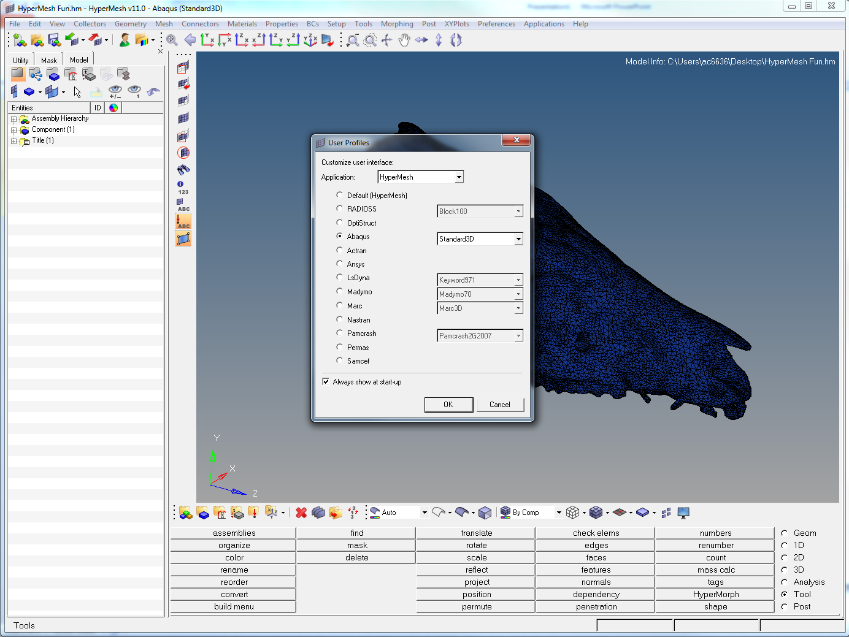
1
2
Notes:
On opening HM the User Profiles screen will appear. This changes what you can and cant use on the menus below. For FEA stuff always choose Abaqus Standard 3D.
To open a file click the Open folder (1), or to import from Avizo , click the green arrow (2)

Slide 2
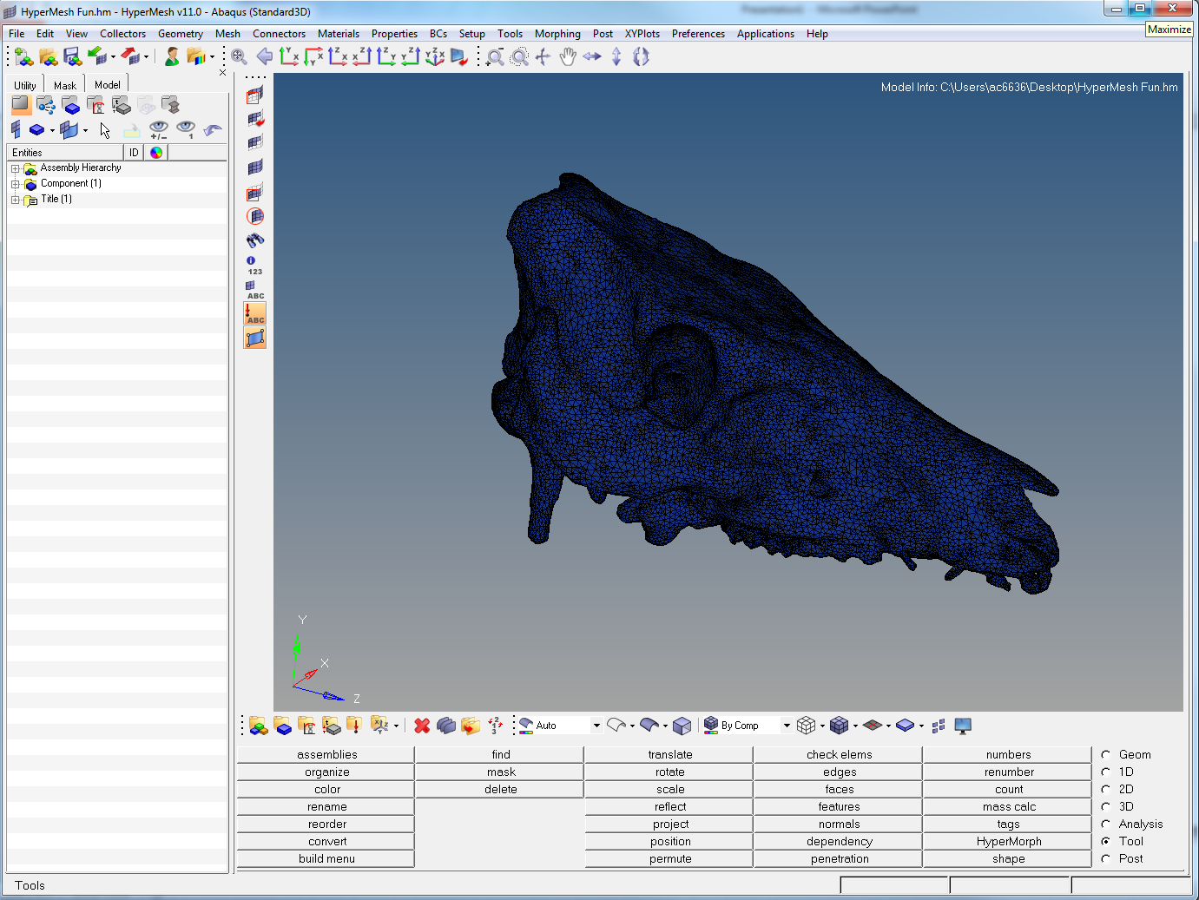
Notes:
The menu at bottom right (highlighted in red box) is the way to access all the different tools needed. Unless otherwise mentioned the 2D, 3D, Analysis, Tool functions are all here

Slide 3
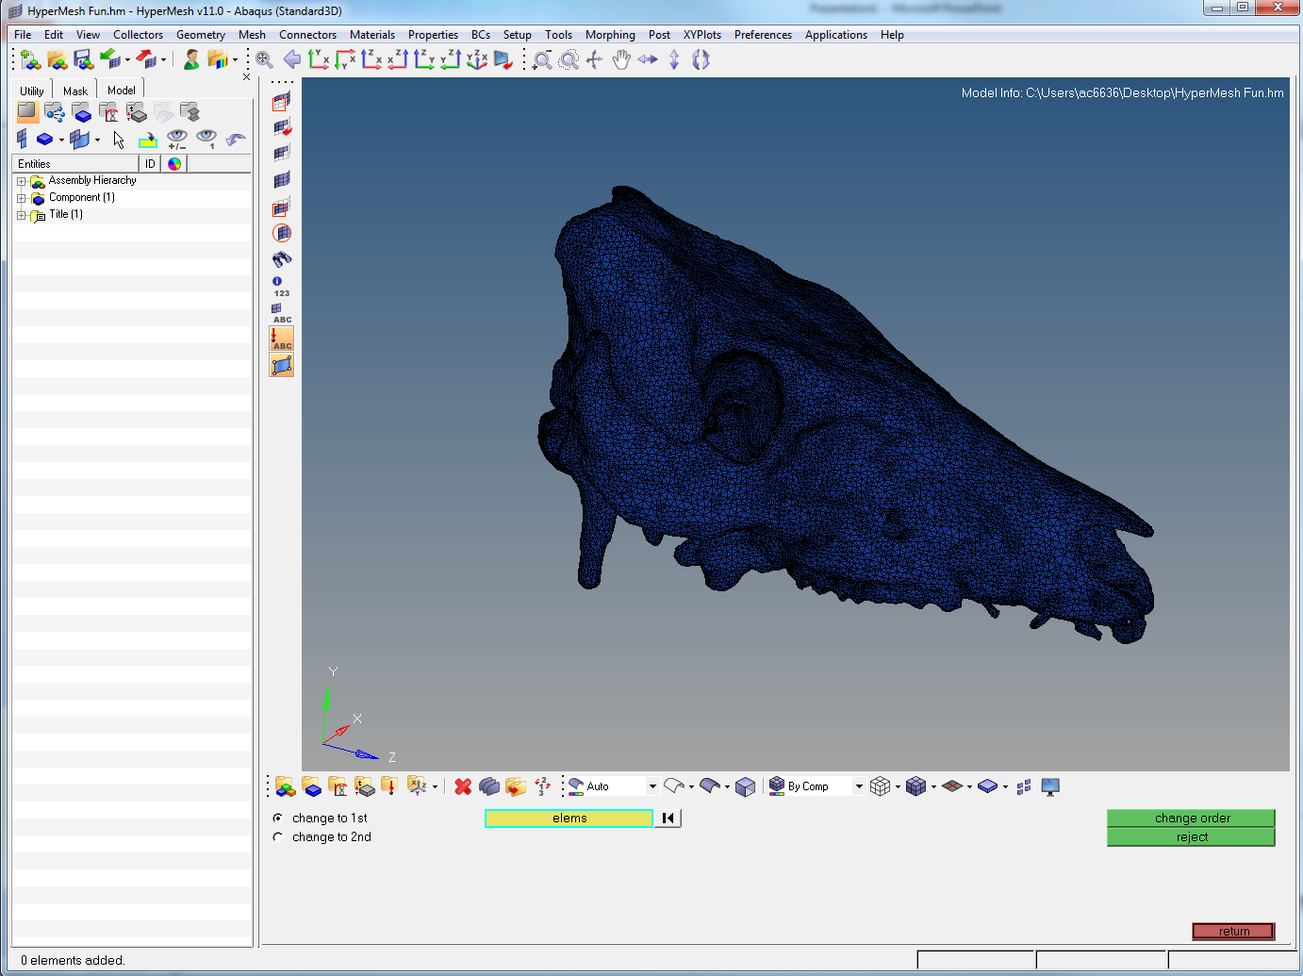
Notes:
To change the order of elements, go to 2D > order change (last column, 3rd from bottom). Hold down the shift key + left click drag over the elements. Make sure change to 1st is selected and click change order. Press return

Slide 4
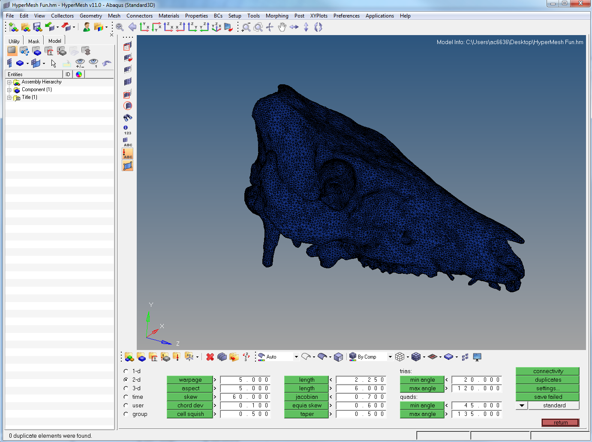
Notes:
Go to Tool > Check elems (F10). Click duplicates (none will be found, but follow the steps anyway as they will be useful for later editing e.g. aspect ratios and min/max angles). Then save failed. Press return.

Slide 5

Notes:
On the Tool panel, you will find a delete button (2nd column, 3rd down. Alternatively press F2). This brings up the screen shown. Click on the elems box (blue highlight) to bring up a new screen (next slide). If the elems is not visible, click the down arrow on the left and select elems from the list

Slide 6

Notes:
Click retrieve to return the saved elements. You can also select many things in many of the menus using this method. If there are any failed elements, they should highlight upon retrieval and the original delete screen should return. Press delete entity.

Slide 7
Notes:
Press return on the delete screen to get back to the main menus list. Now it is time for intersections/penetration checks. Click Tool > penetration (4th column, bottom)

Slide 8
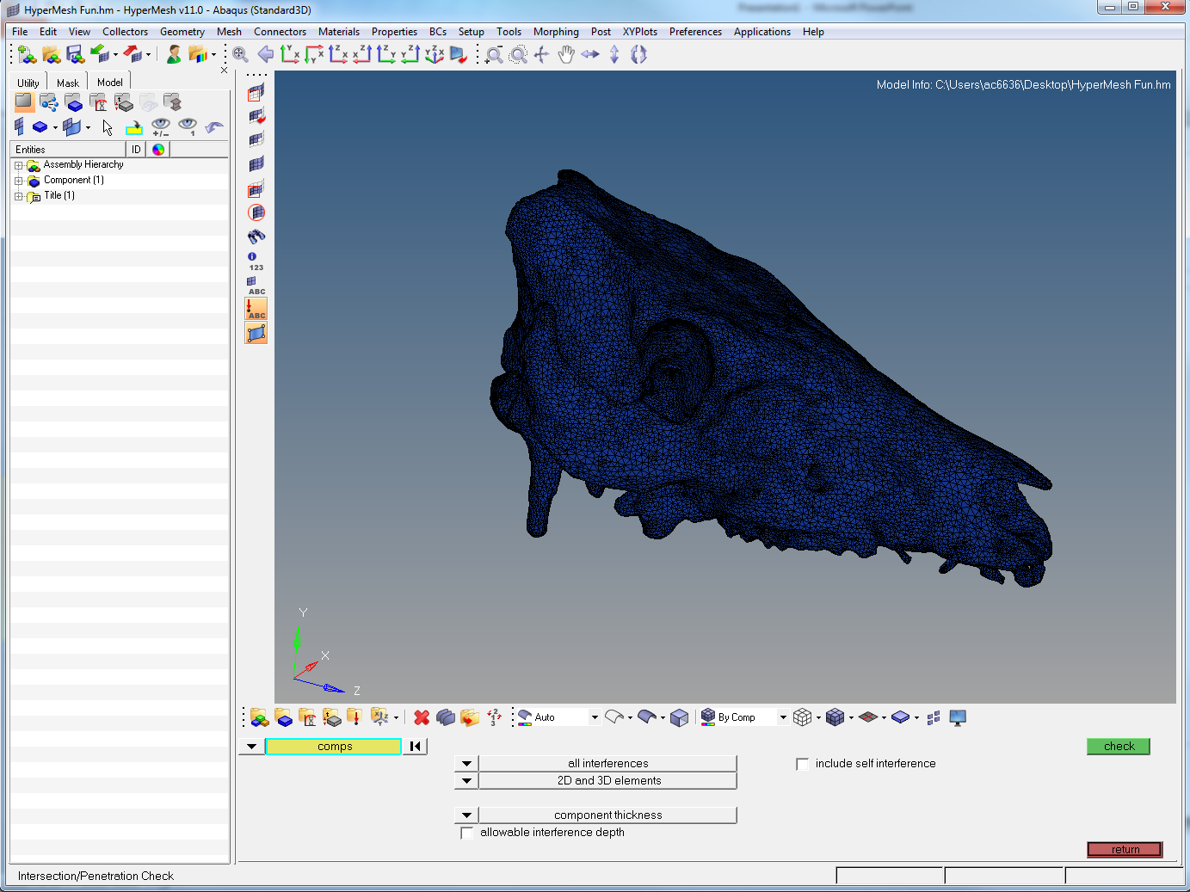
Notes:
This screen appears. Make sure the comps is selected (blue highlight box. Select from dropdown if elems is preselected. Doesn’t really make any difference, just saves the shift+left click drag to select all). Click the box to include self interference

Slide 9

Notes:
This should appear. Press check.

Slide 10
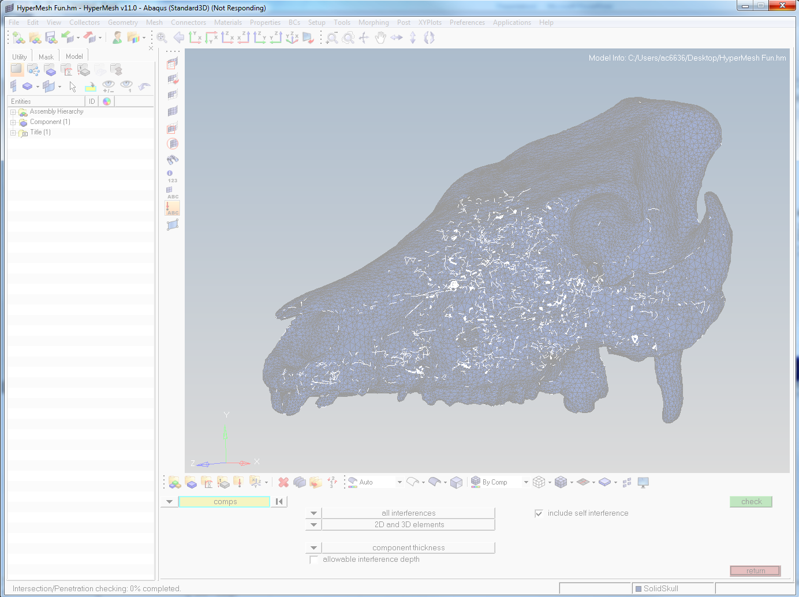
Notes:
This check will take a while, and often it will say Not Responding at the top. Just give it time (up to 10 minutes depending on the complexity of the model). If you click back on the hypermesh window during this time, it will probably go white as above. Just give it time.

Slide 11
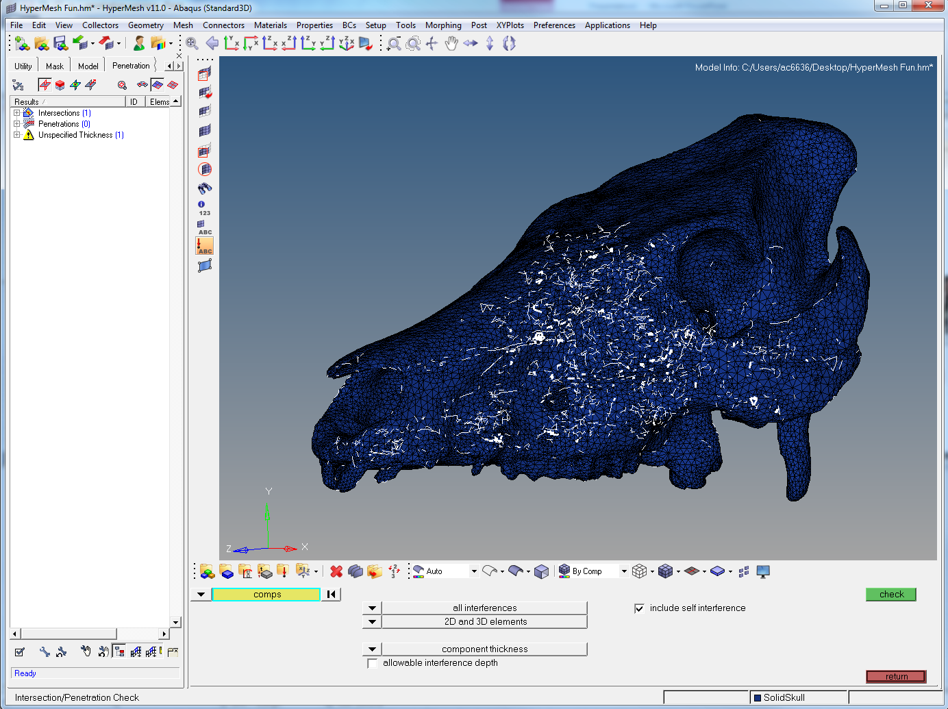
RESULTS ^
Notes:
A new tab appears with your results listed. Click the Intersections (1) to reveal the number of failed/intersected triangles.

Slide 12
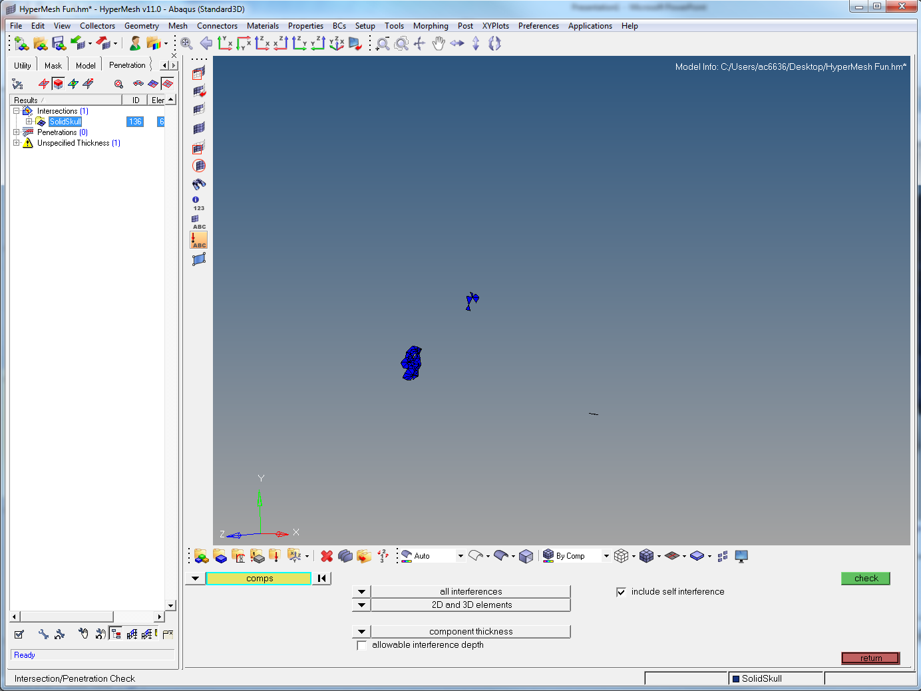
Notes:
To view the failed elements click the two buttons near the top of the tab (arrows). Zoom in on the area highlighted in red (ctrl + mouse wheel)

Slide 13
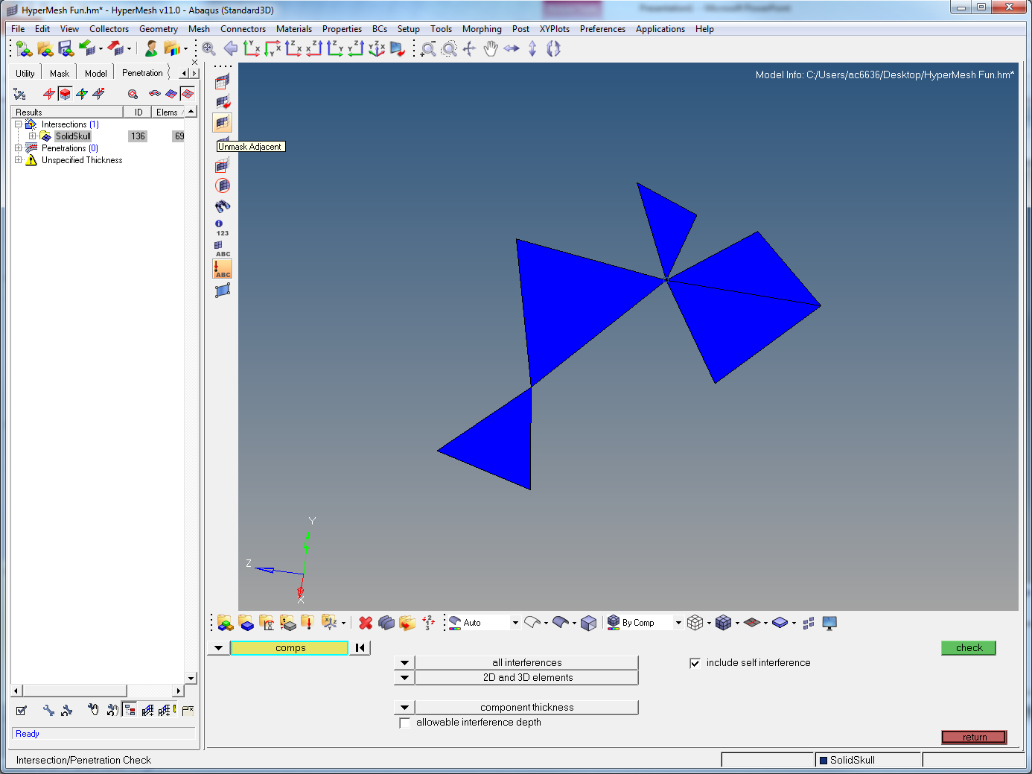
Notes:
You are now viewing some failed elements. It may not be obviously clear what the problem is so you need to view the surrounding triangles. Click Unmask adjacent (red arrow, or hover over the panels to see what they are).

Slide 14
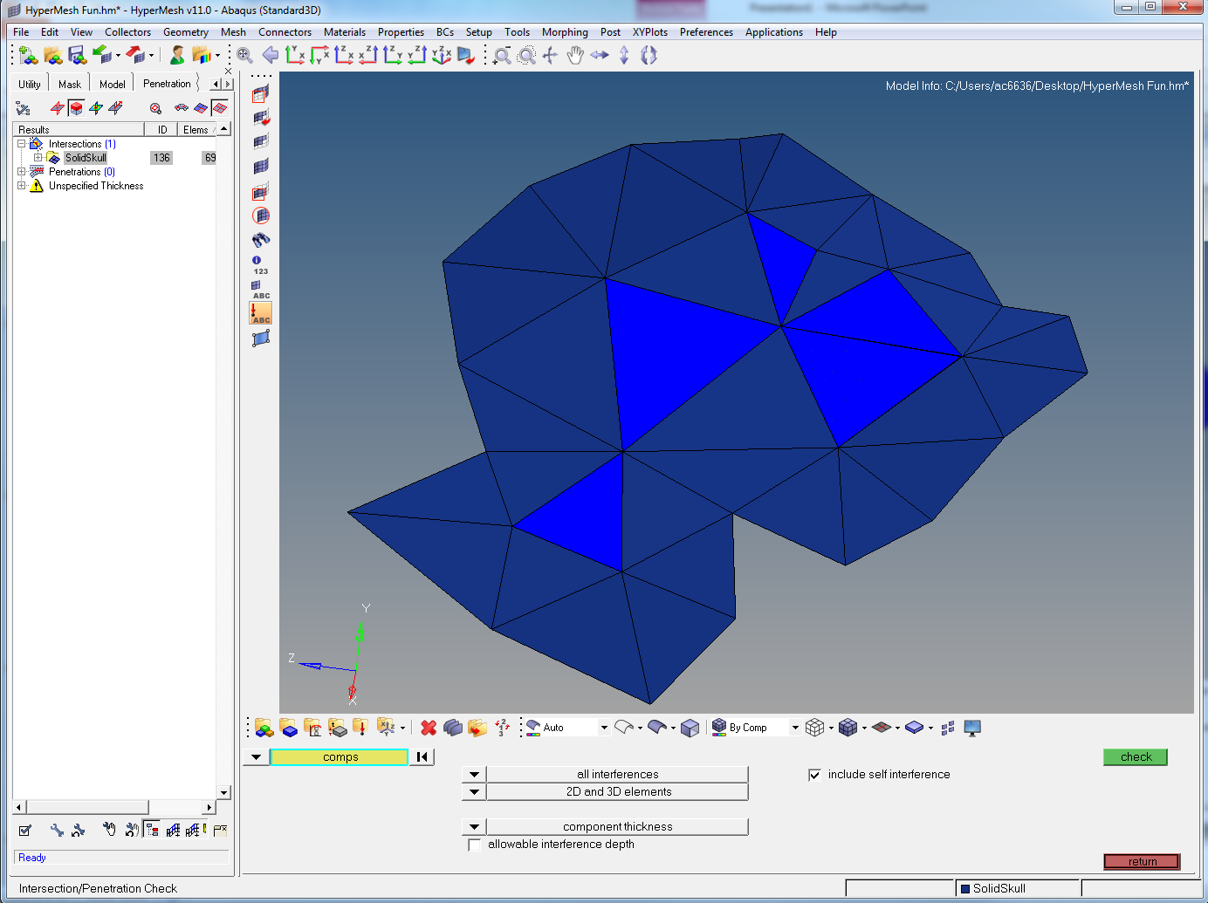
Notes:
This should appear. It is still not obvious what the problem is…

Slide 15
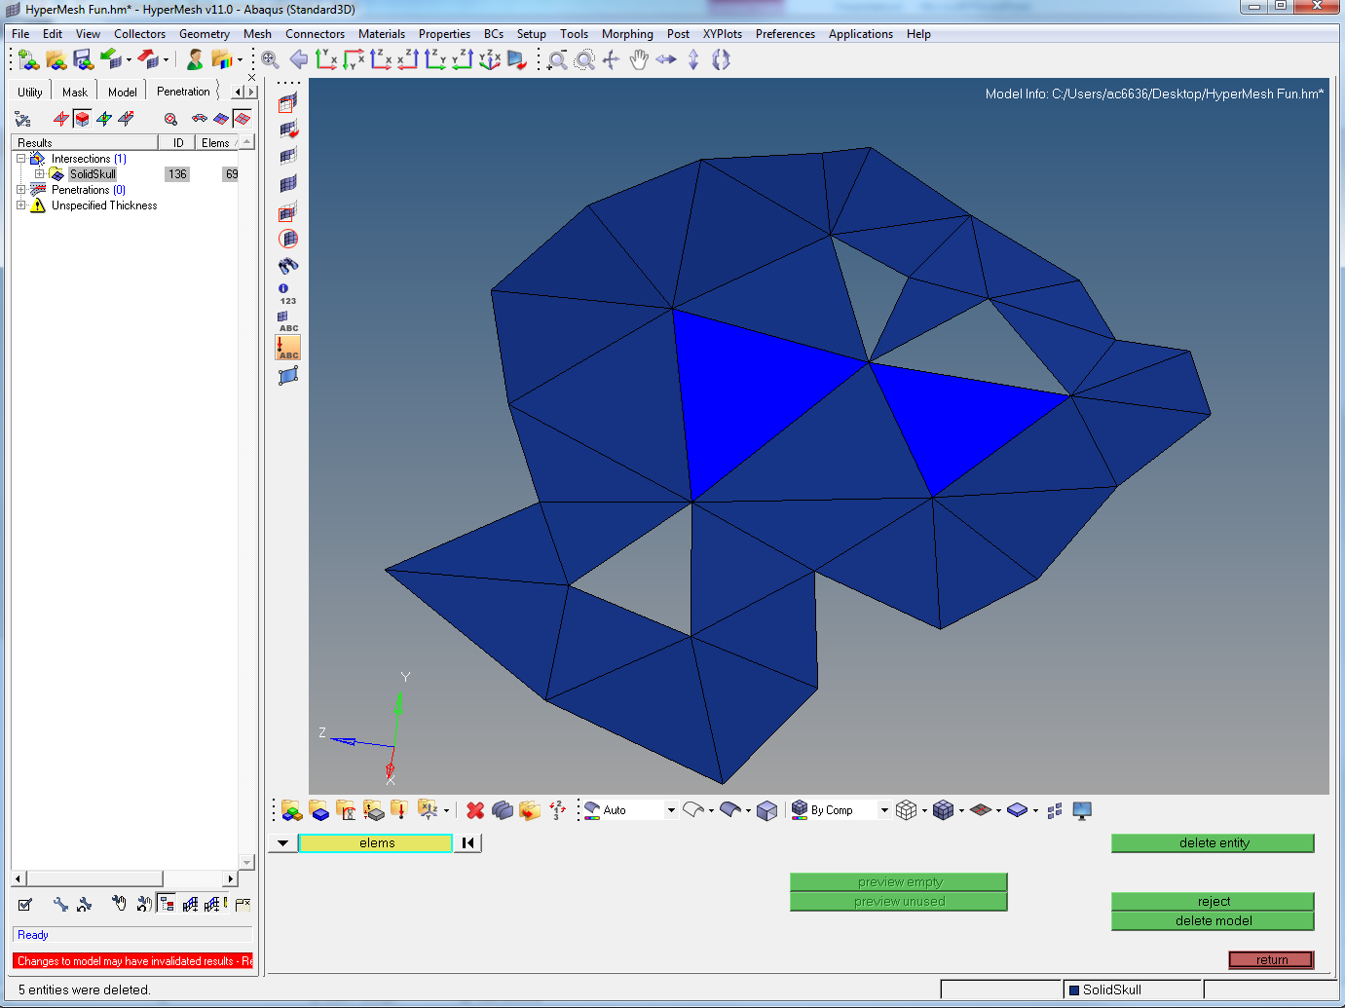
Notes:
Simplest way to deal with these issues is to delete the problems and rebuild them. To do this, Tool > delete (F2 – as before). Click on all of the light blue elements and press delete. 5 entities will delete, but 2 more remain… Problem? I think this might be it.

Slide 16
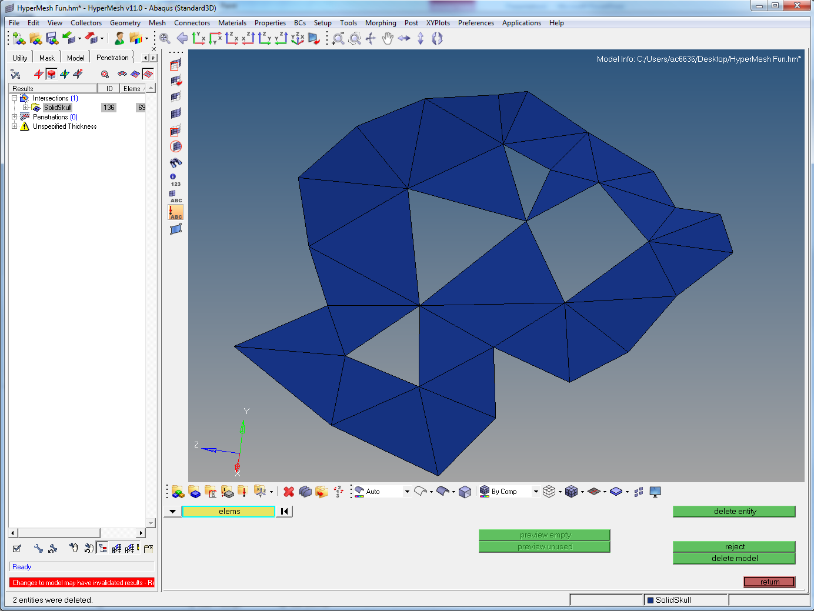
Notes:
Delete those last 2 elements too.

Slide 17
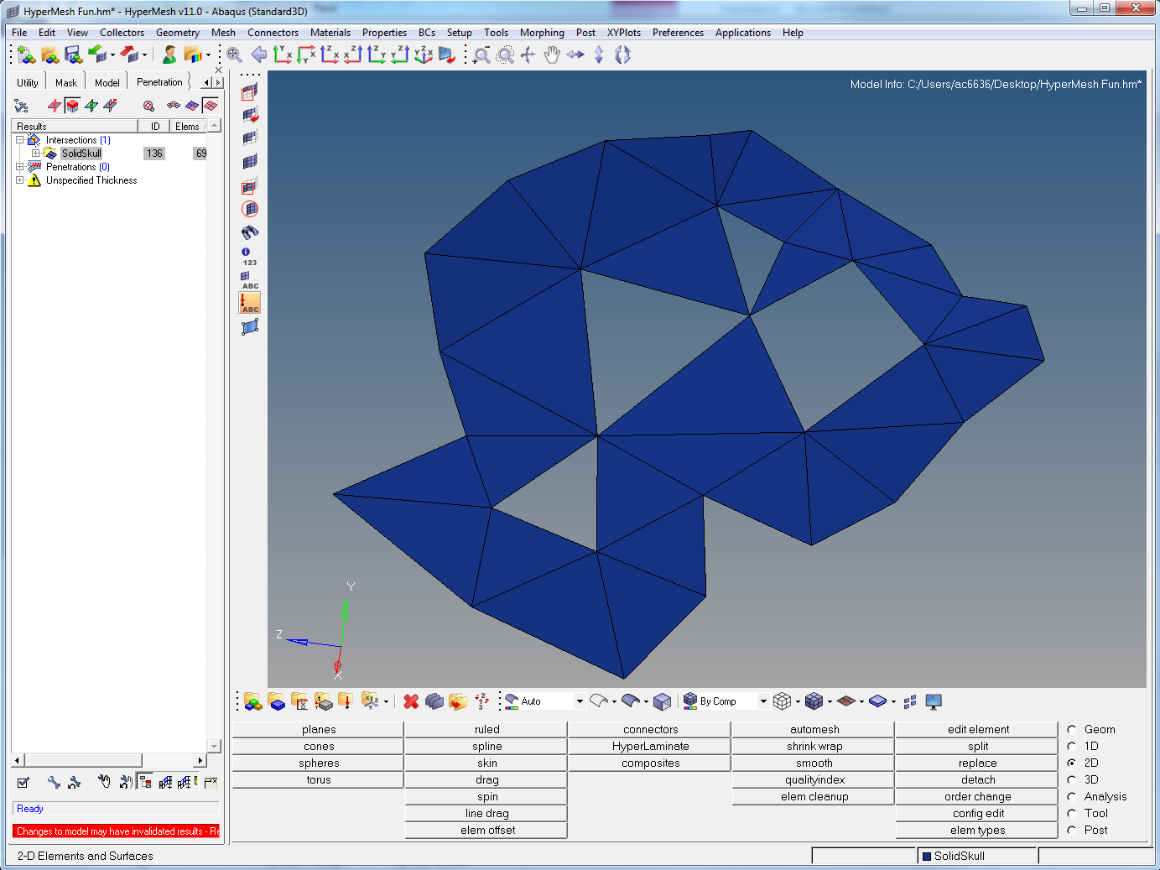
Notes:
Now we need to repair the holes. Go to 2D > edit element

Slide 18
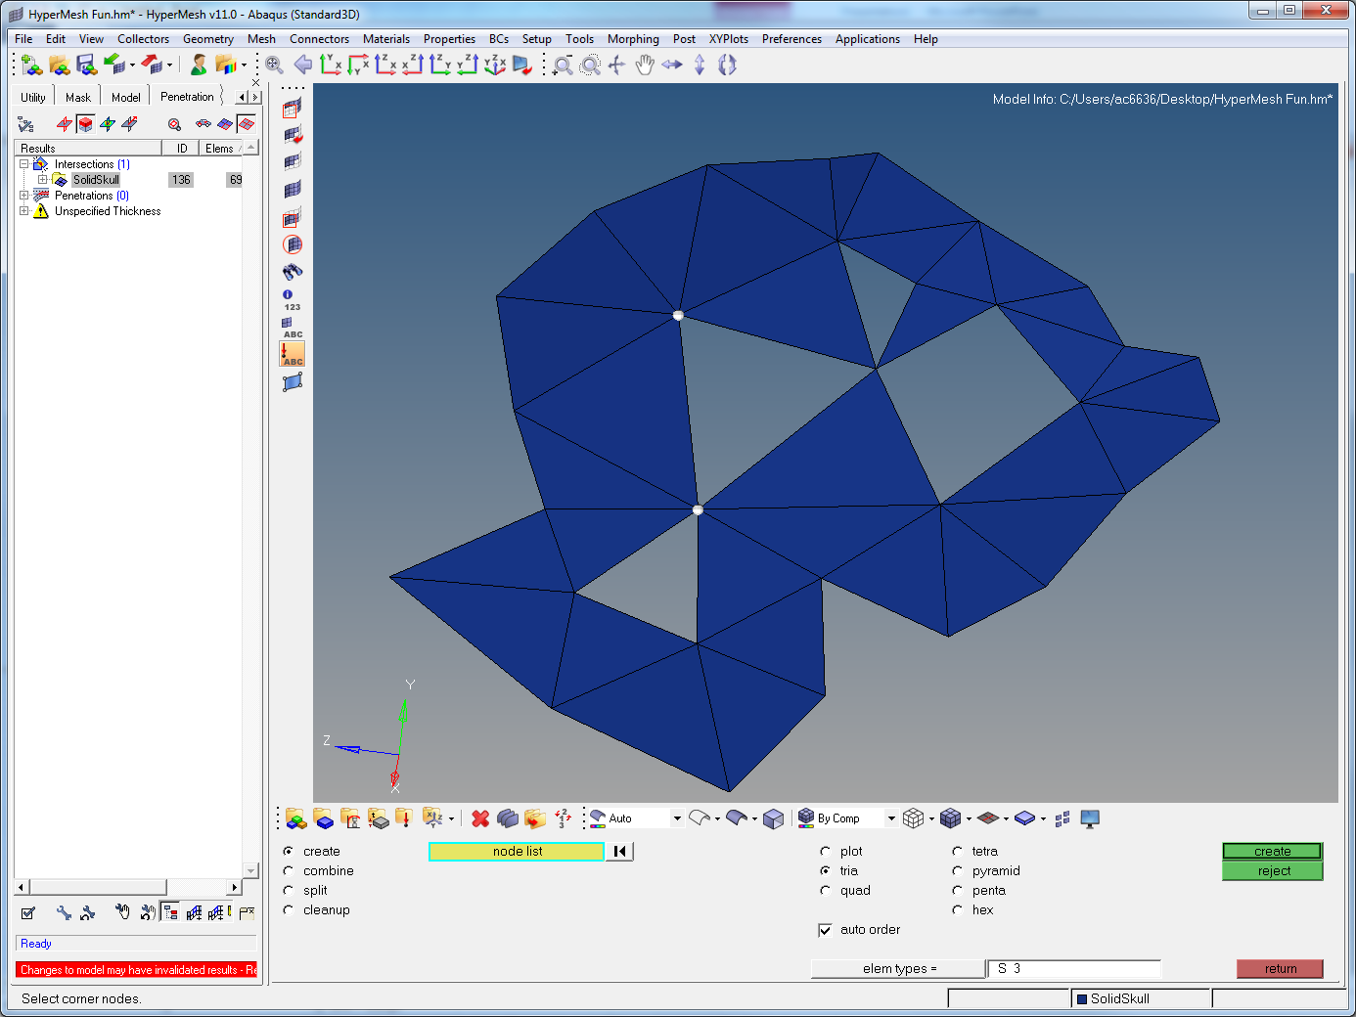
Notes:
This panel (a very useful one for editing elements, hence the name) appears. From here you are able to create, merge or split elements easily. To fix the current problem, make sure create and tria are selected. Click the corner nodes where you want your triangle to build (in above example just need to click the left node to build the triangle).

Slide 19
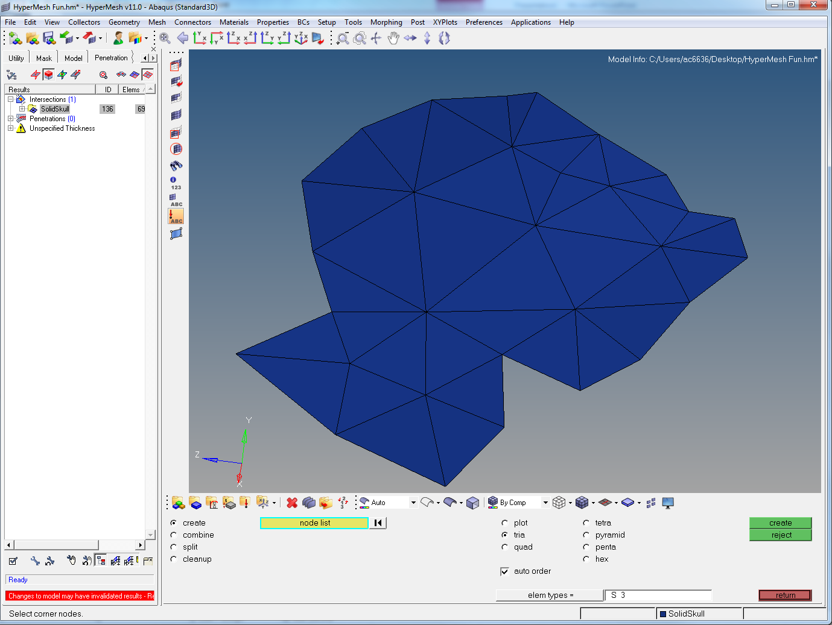
Notes:
Repeat for the remaining triangles until your model appears something like this. If you mess up, right click to undo a build or on highlighted nodes to deselect them.

Slide 20
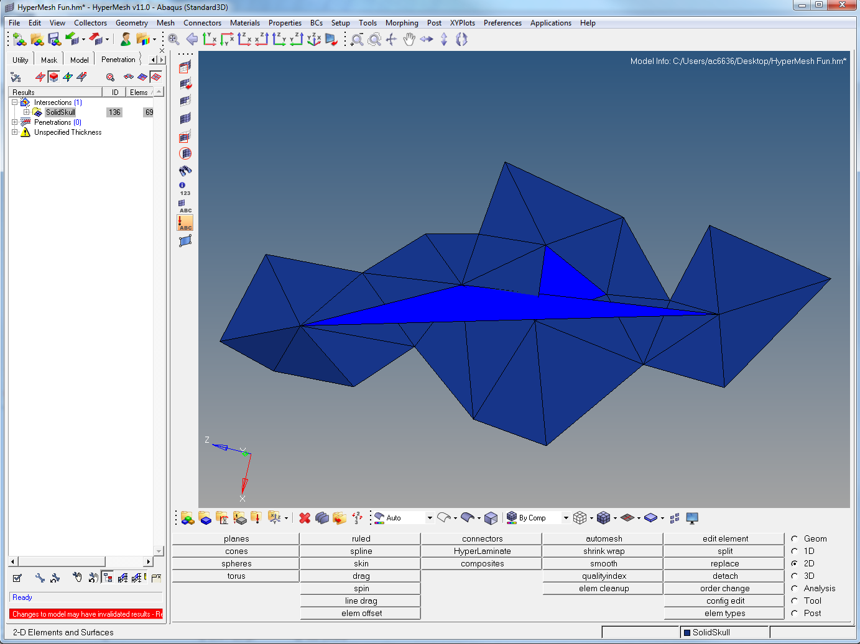
Notes:
Scroll across the screen (right click drag), until you find this area of failed elements.

Slide 21
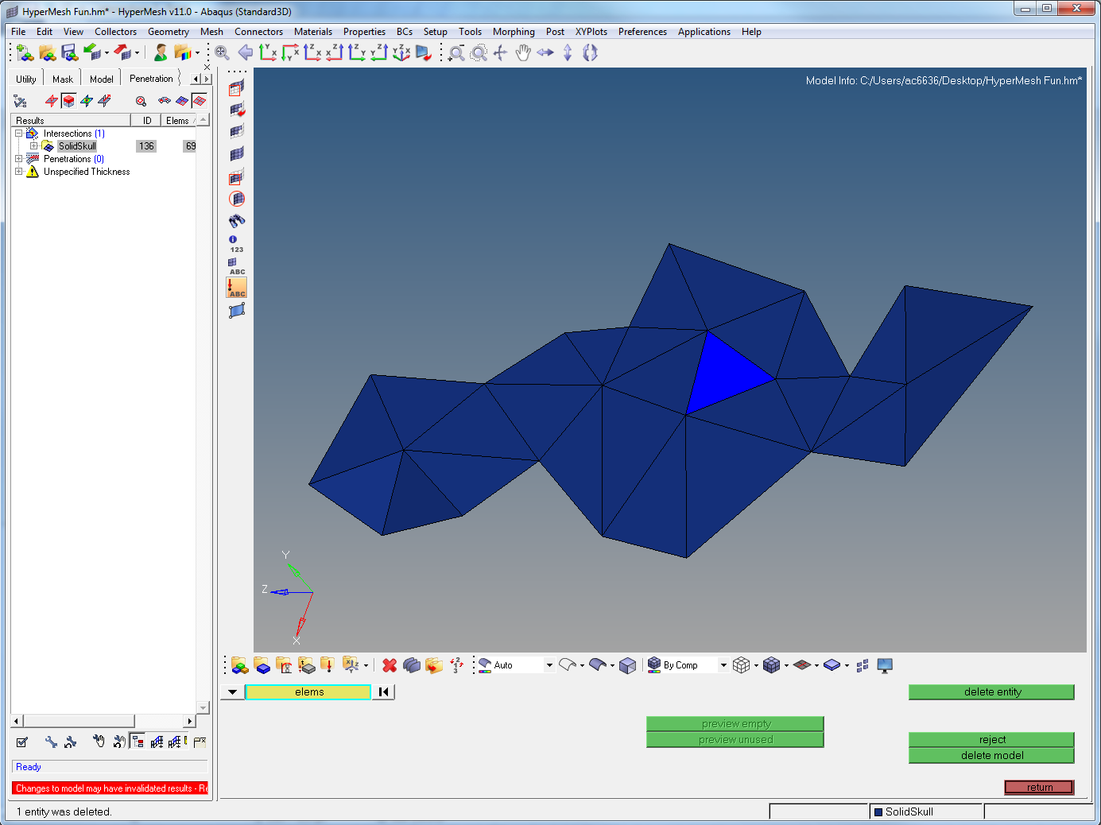
Notes:
Go the delete panel (Tool > delete or F2 – last time of telling) and delete the big lighter blue element that goes across the screen.

Slide 22
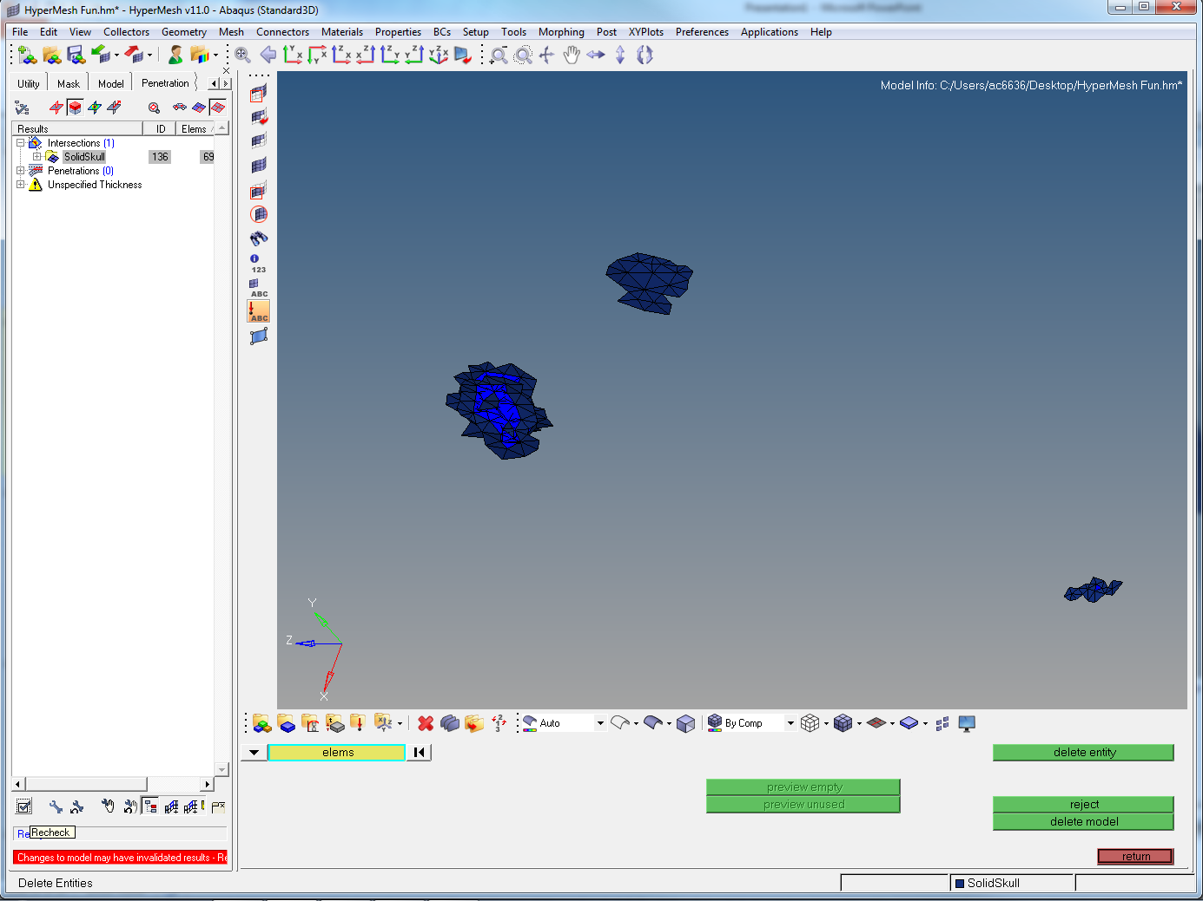
Notes:
Now you want to recheck the model to make sure you’ve fixed those ones. Click the tick box (red arrow. Hover over to show names)

Slide 23
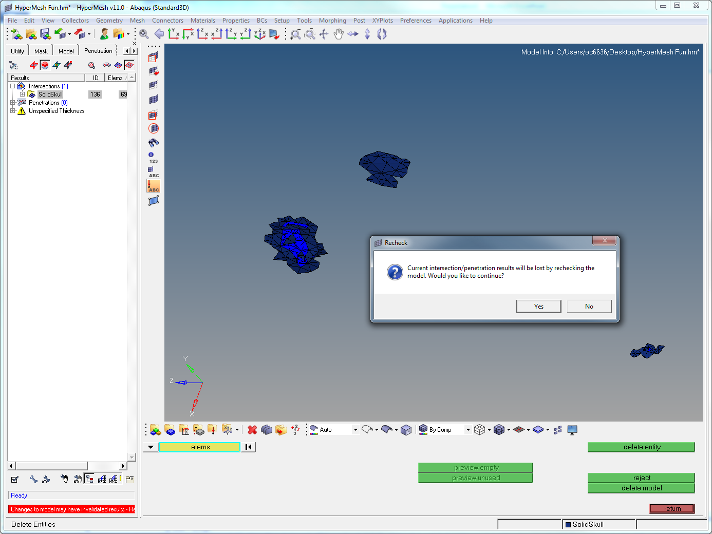
Notes:
Click Yes

Slide 24
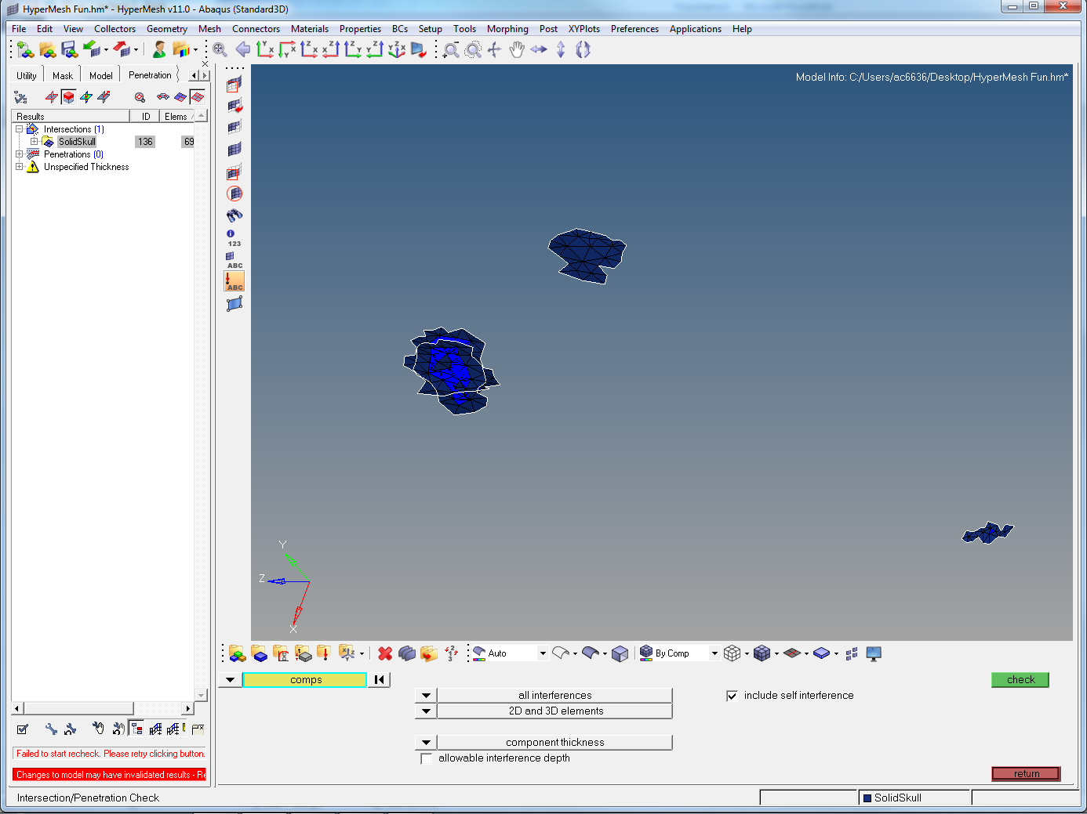
Notes:
It often fails… but it will get you back to the penetration tab rapidly. Click on one of the elements again, and click check.

Slide 25
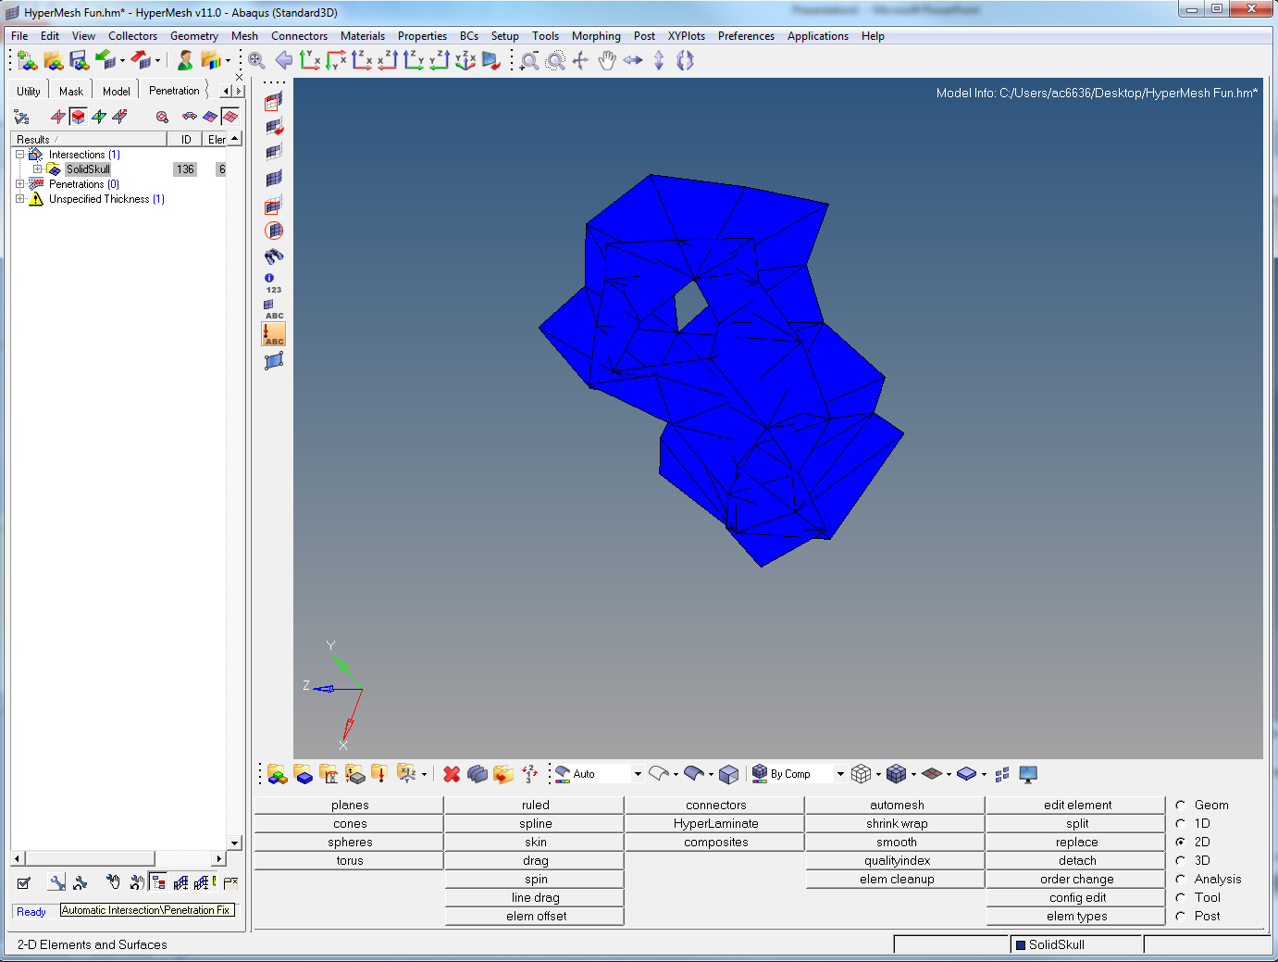
Notes:
Again click Intersection (1) to reveal the number of failed elements, then the two buttons to show just them. Attempt to autofix these failed elements by clicking the little wrench at bottom left (small red arrow)

Slide 26
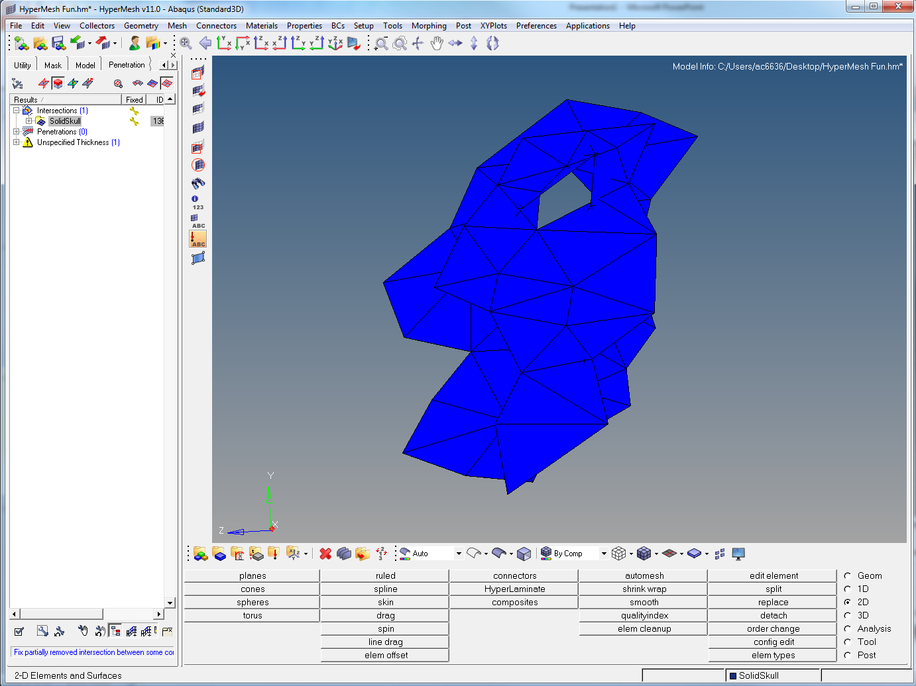
Notes:
You can see the new little yellow wrench appears by the number of failed elements (top left arrow) and you should see that some of the elements are no longer obviously intersected (big arrow, middle of screen)

Slide 27
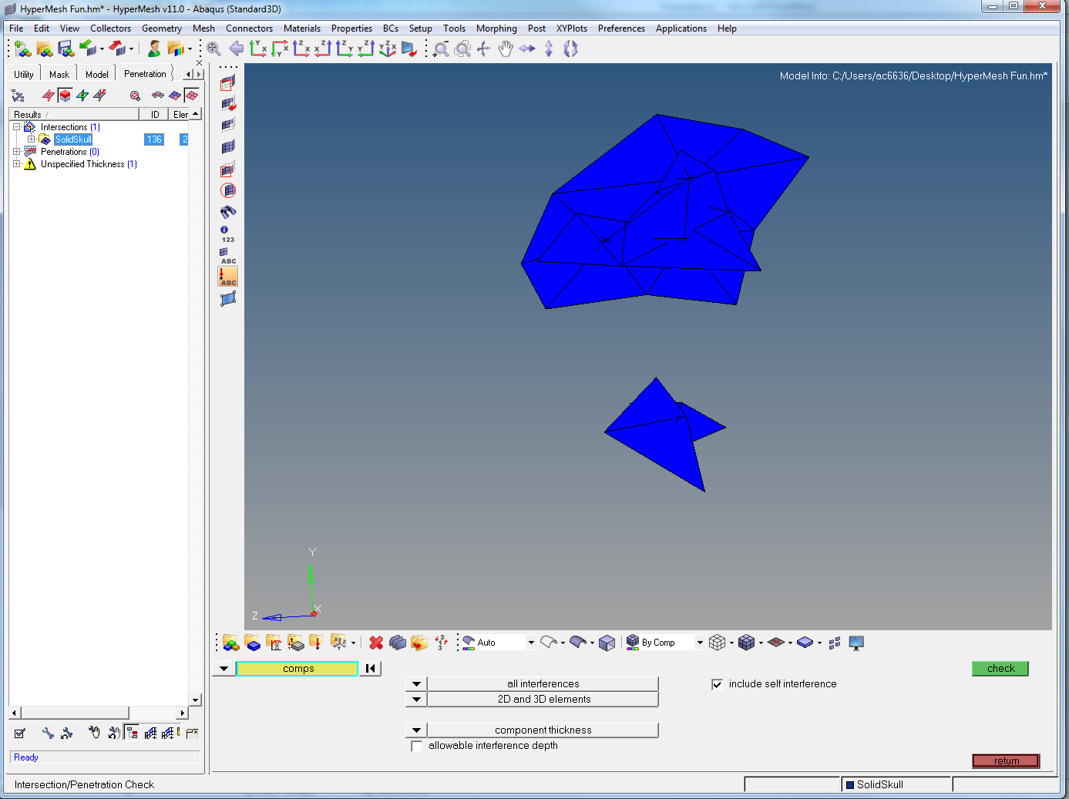
Notes:
Recheck again and display the failed ones again. You can see there are only a few left that are still intersected. You can either autofix these again, or manually correct the error (recommended in this case and a useful tool to use)

Slide 28
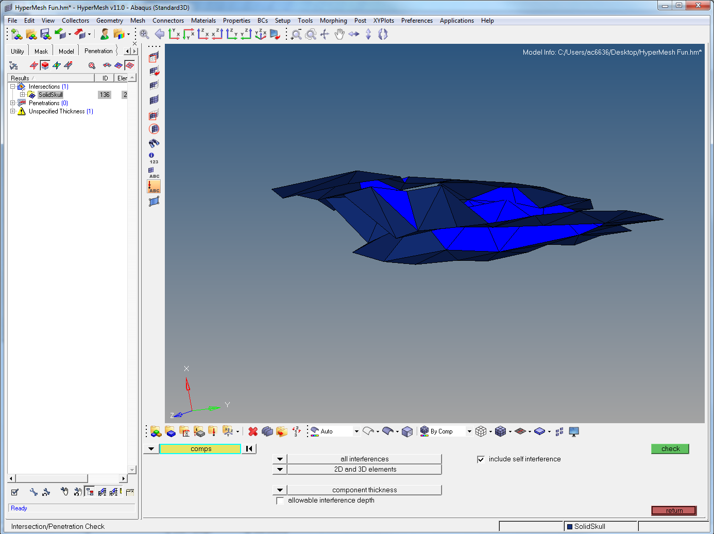
Notes:
Unmask adjacent once and rotate the area (ctrl+left click drag). To change point of rotation ctrl+left click node. Here you can see that the two layers have collapsed onto each other.

Slide 29
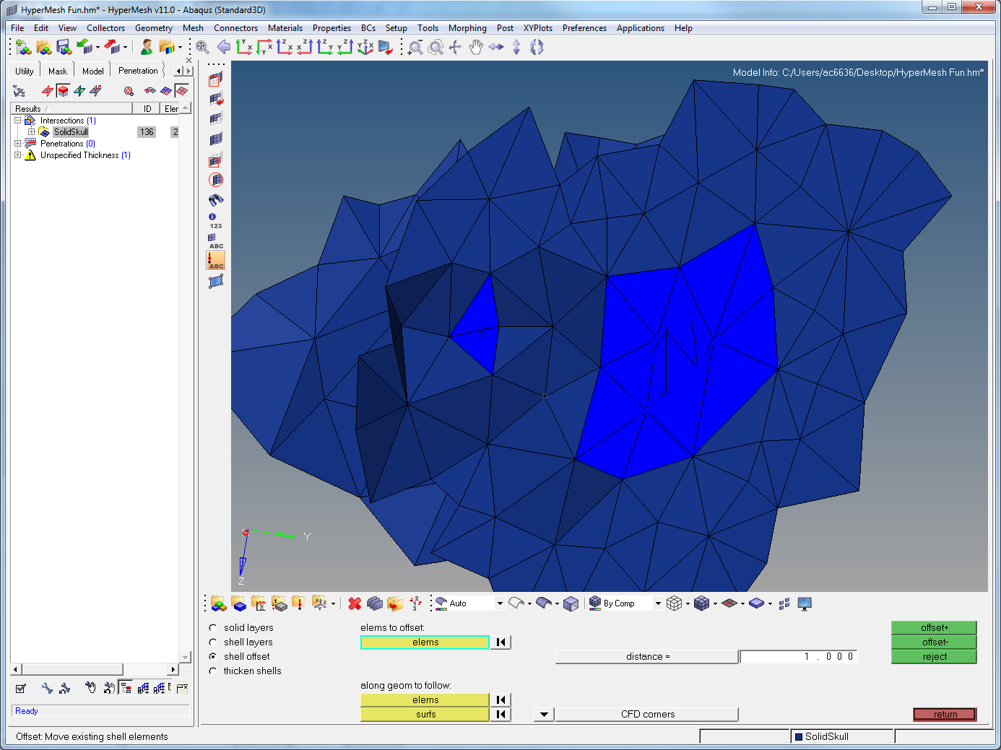
Notes:
Unmask adjacent again to see how far the collapsed area extends.

Slide 30
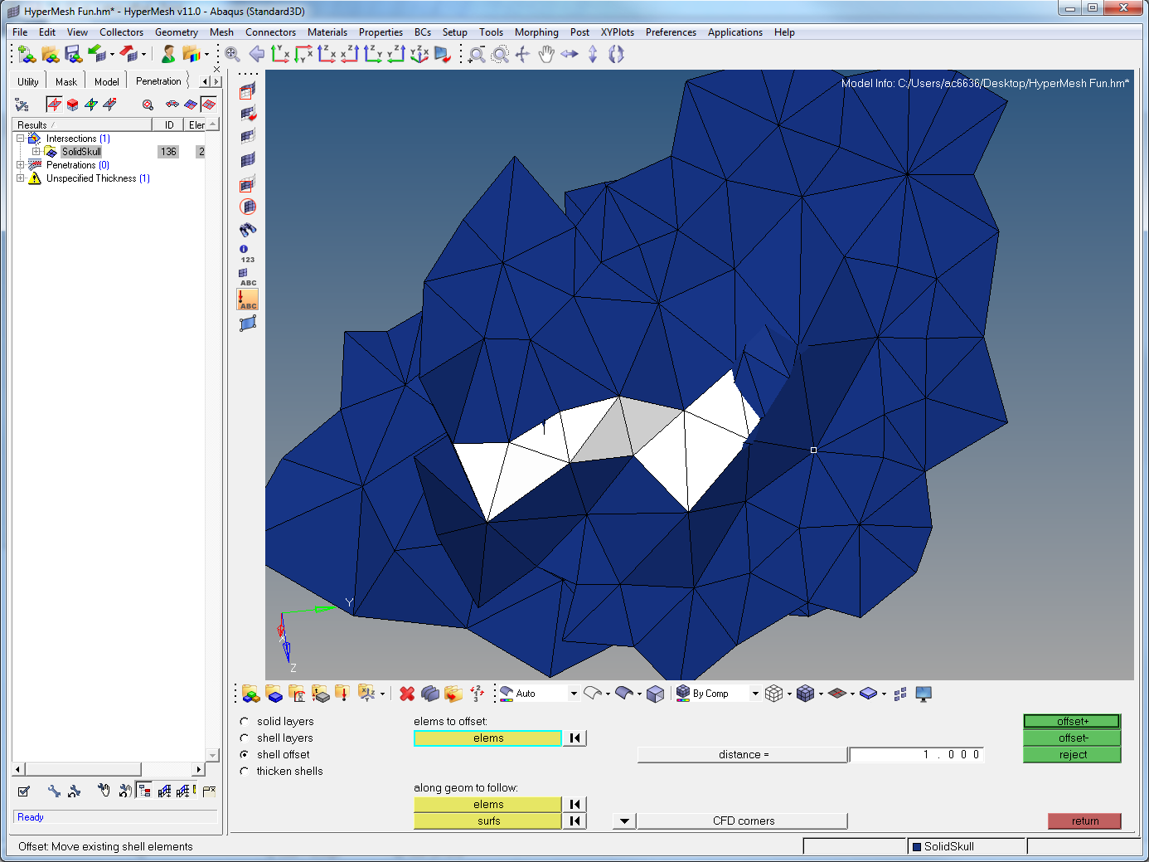
Notes:
Deselect the failed and select the highlight failed elements (next to the review failed elements). You will need to unmask adjacent again to expose everything again, but it will make it clearer for the next bit. Then go to 2D > element offset (2nd column, bottom). Make sure shell offset is selected, then click on the elements at the lowest point of the collapse (as above).

Slide 31
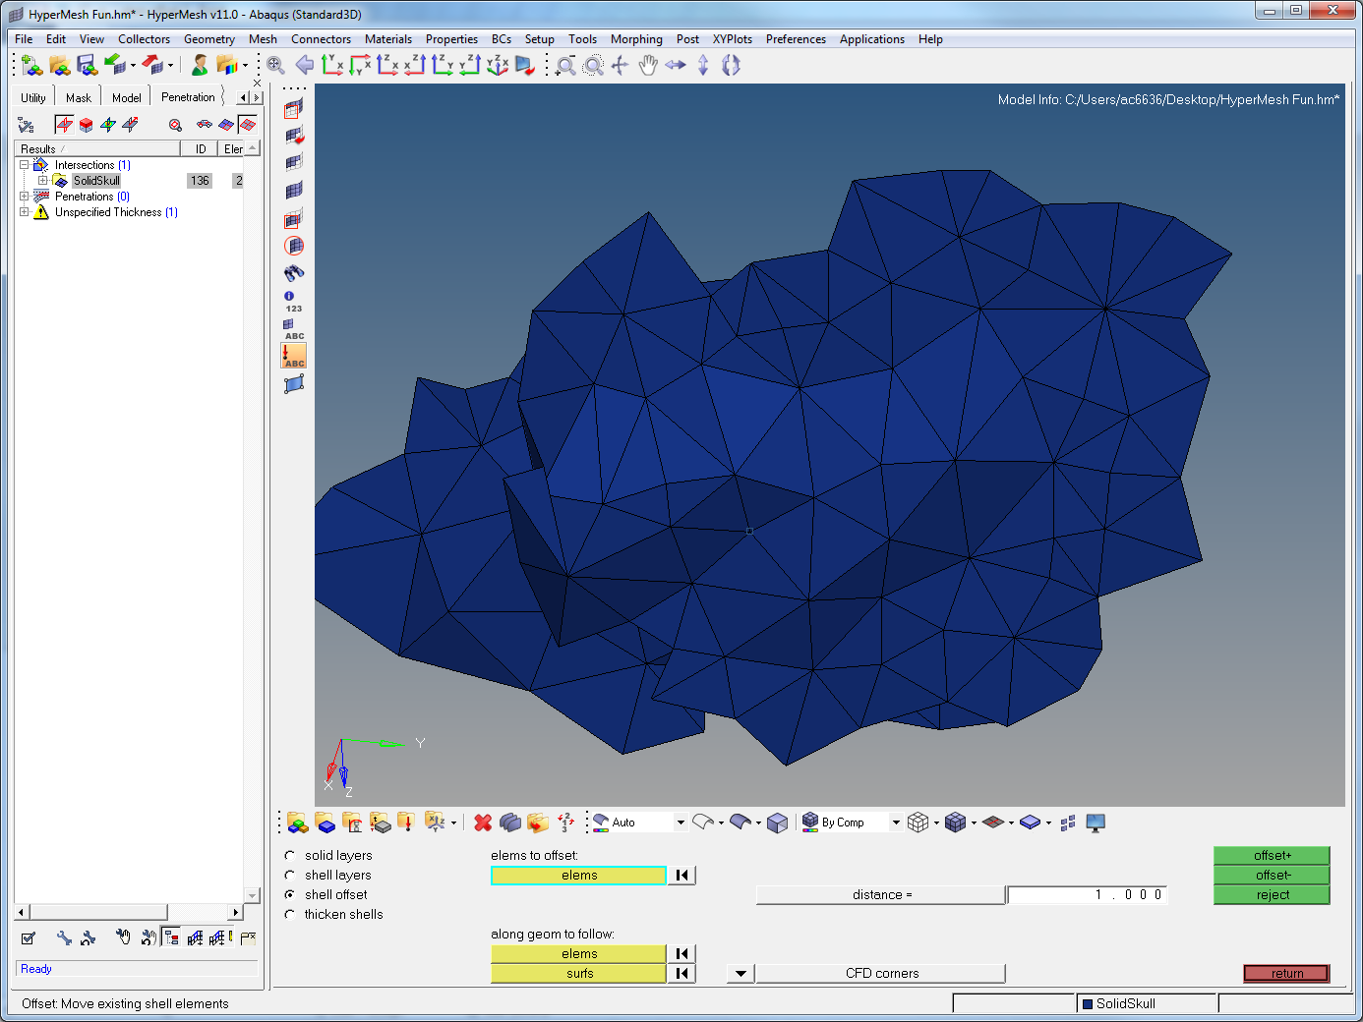
Notes:
A problem with the offset is it is not always clear if you want an offset + or an offset - . Try one and if it makes it worse, reject and press the other. Also note the distance is in whatever ambiguous measure HM wants. Often its in mm/cm depending on the scaling of your model. If unsure, just go to Geom > distance and click 2 nodes on a triangle to give you a rough idea of how big each is.

Slide 32
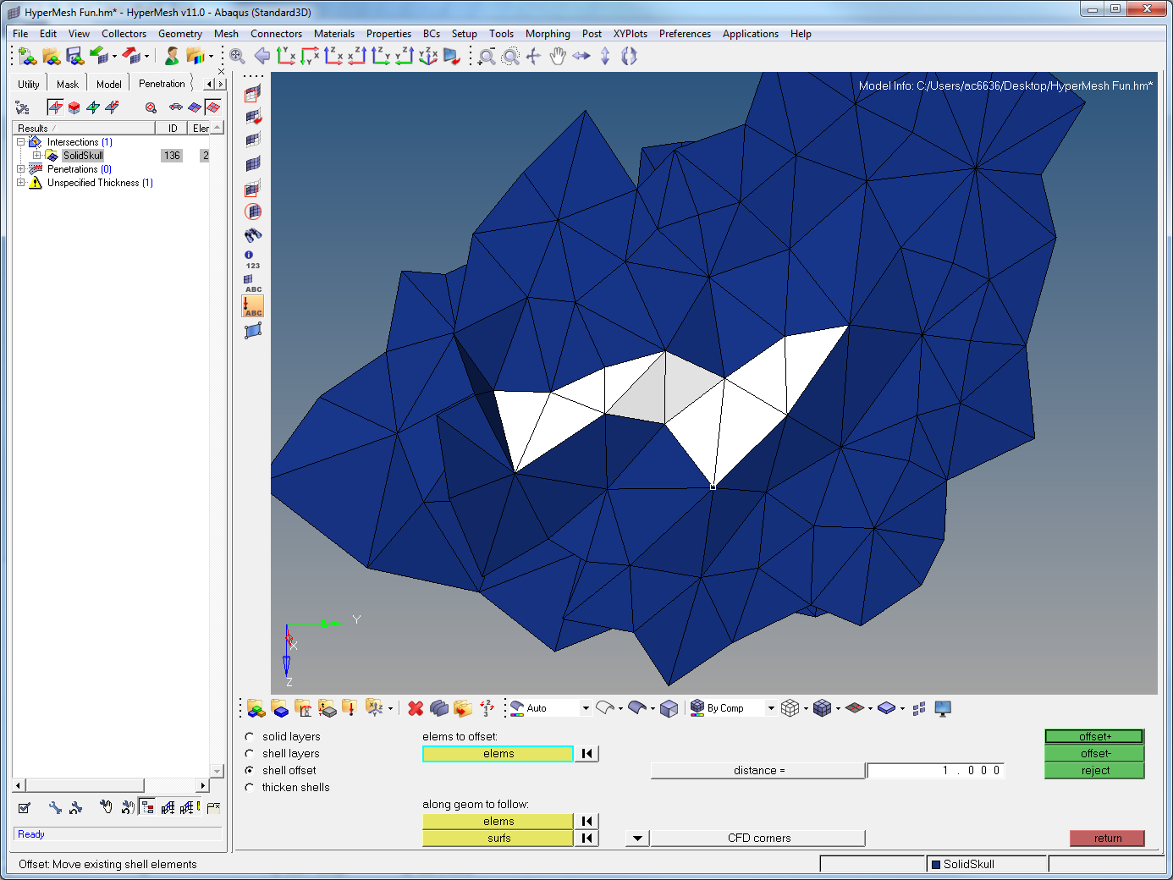
Notes:
Feel free to rotate the model and look if it has fixed the problem. I think it needs another offset of roughly the same amount. Highlight elements and repeat

Slide 33
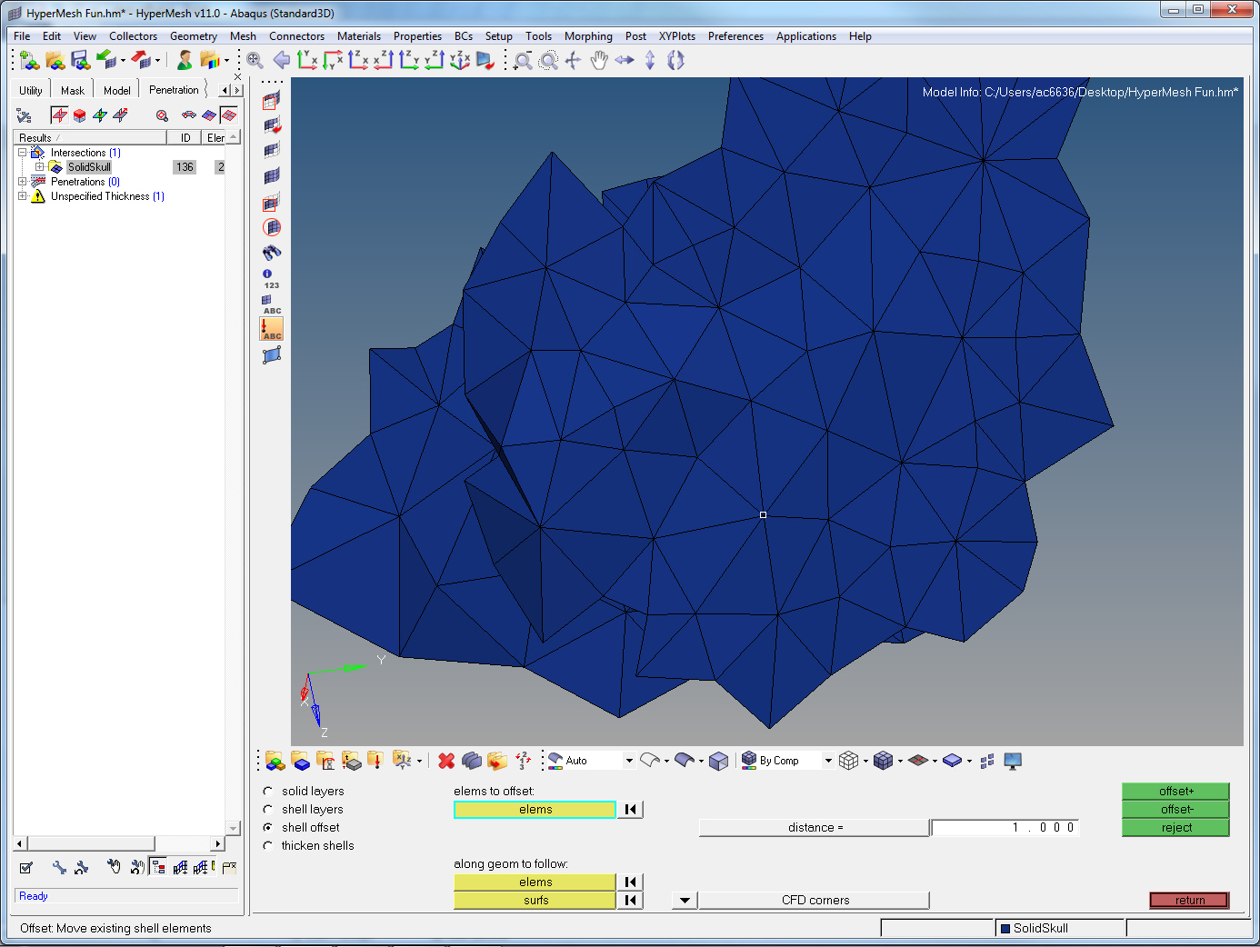
Notes:
It now looks relatively normal from above, rotate and check the side

Slide 34
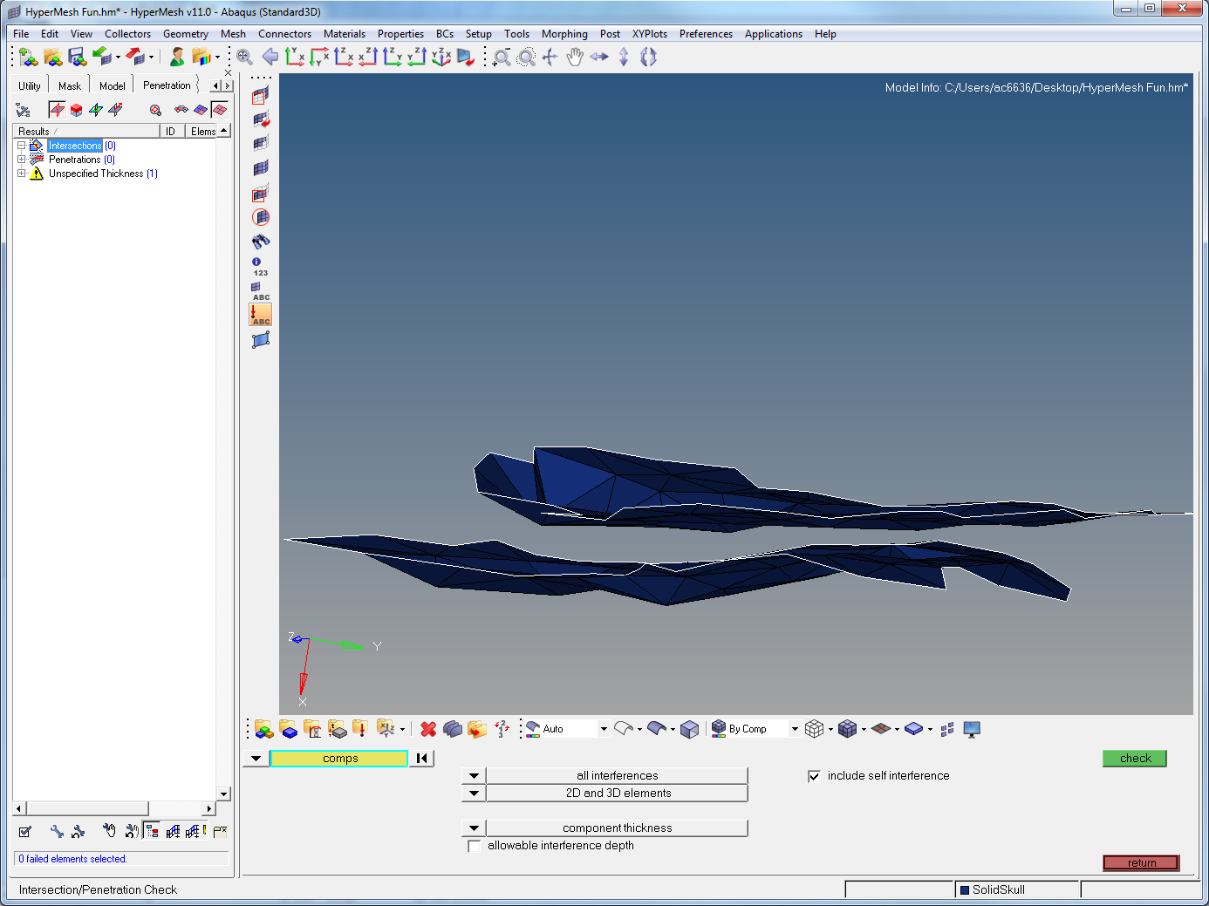
Notes:
Looks good! Recheck penetrations

Slide 35
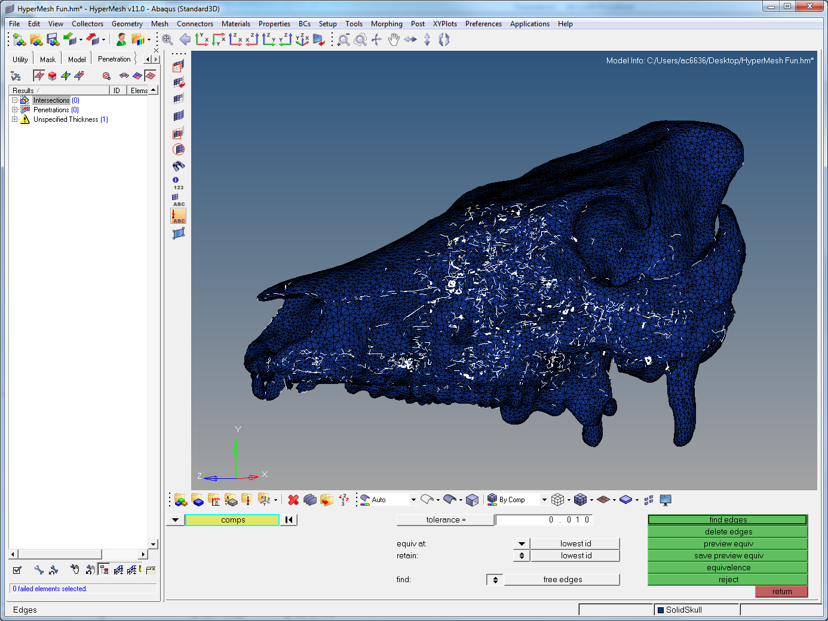
Notes:
Now time to check t-connections. Tool > edges (4th column, 2nd from top or Shift+F3). It reveals this screen. Click the up/down arrow next to free edges. This will change to t-connections. Click on the skull and press find edges. Some number of edges will be found.

Slide 36
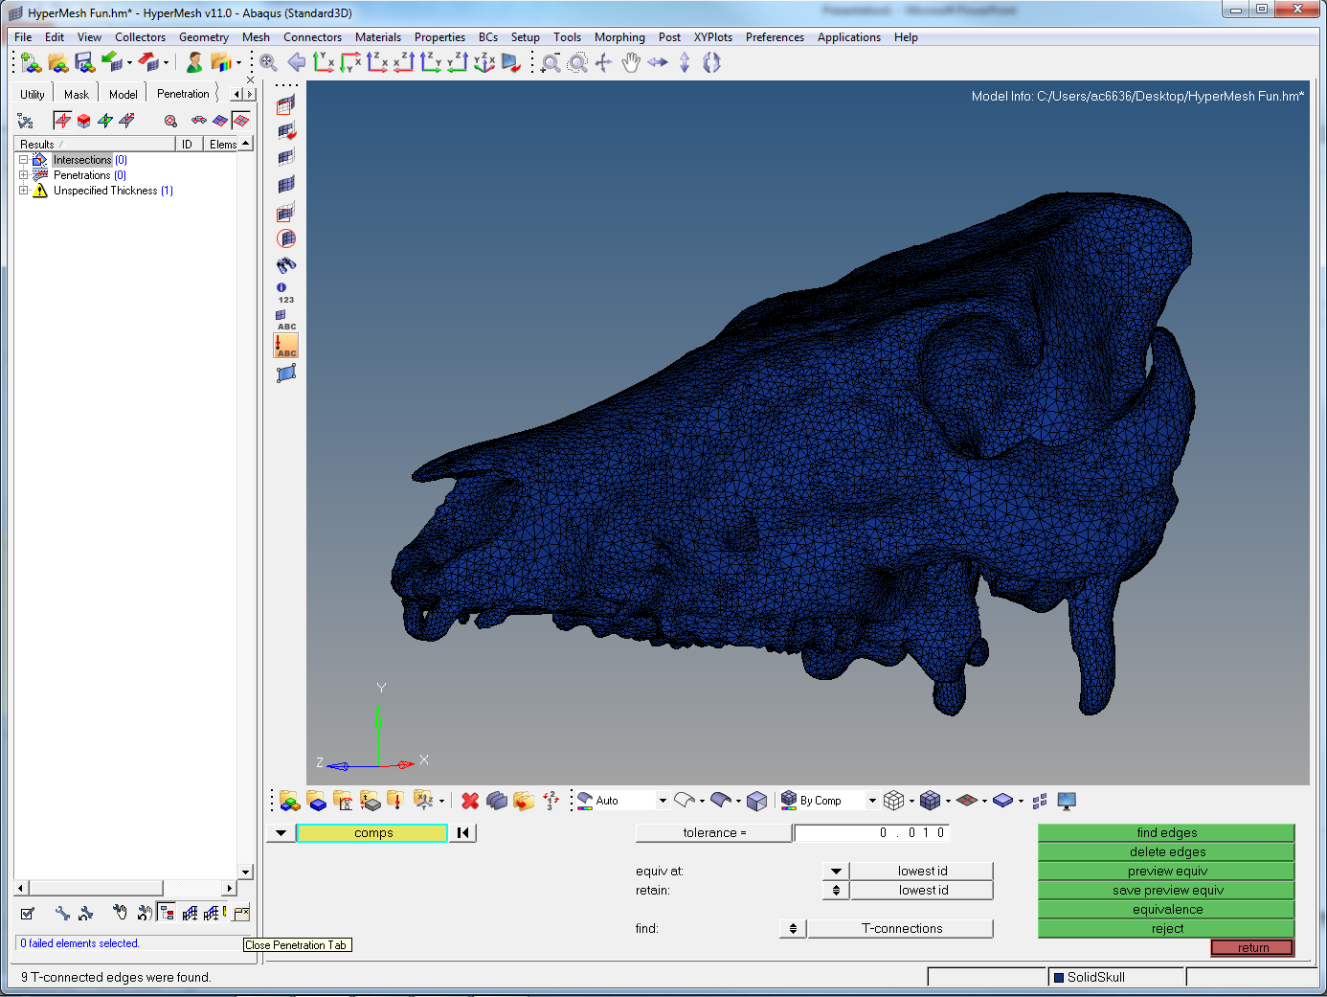
Notes:
The easiest way to display them is to close the penetrations tab (click the button marked by red arrow)

Slide 37
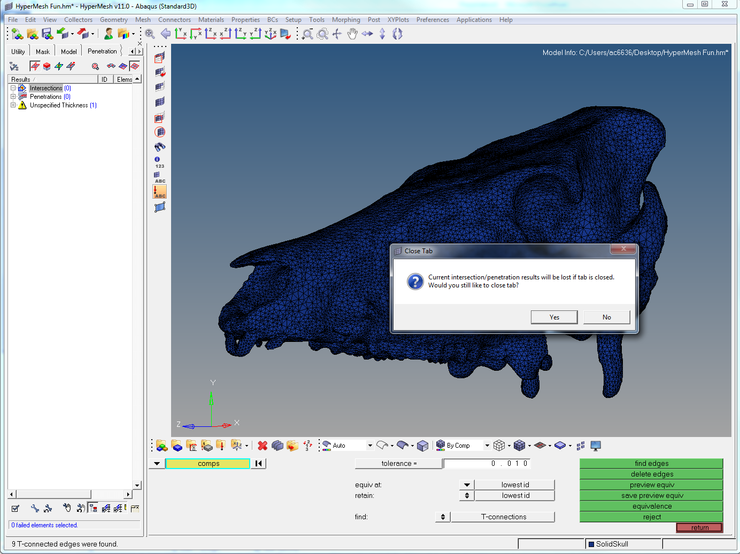
Notes:
Click Yes

Slide 38

Notes:
Make sure you are on the Model tab. Here you will see a new material called “^edges” has appeared. These are your t-connections.

Slide 39
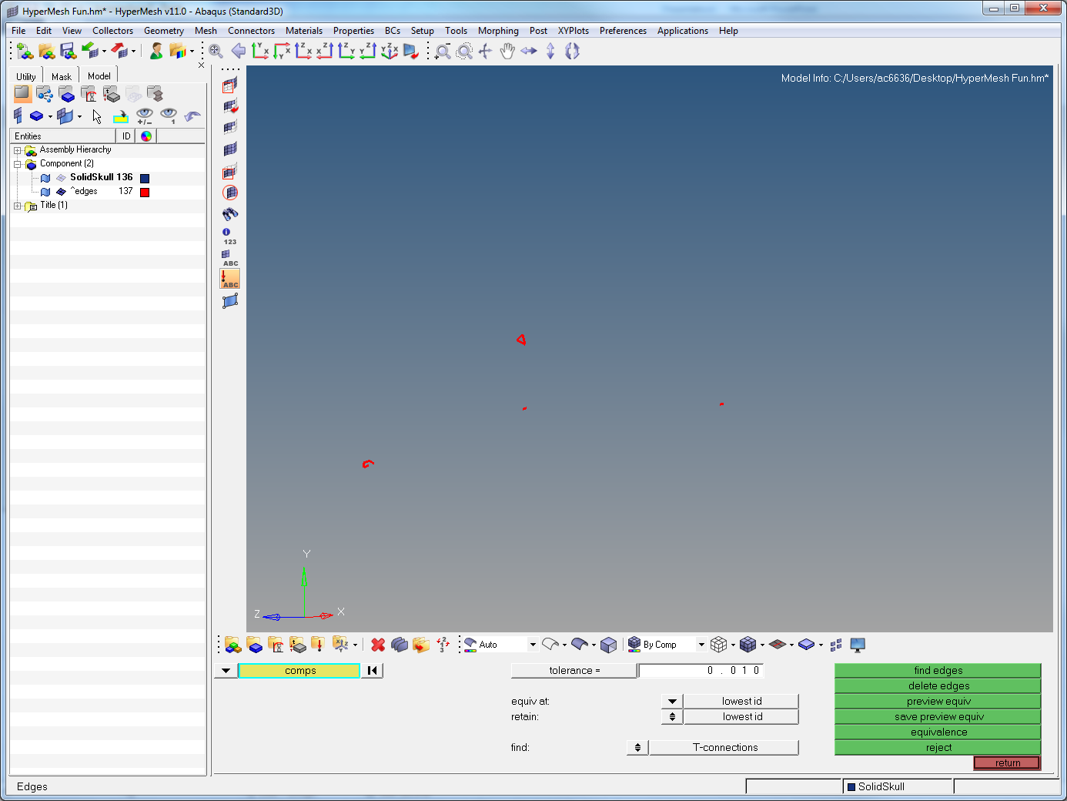
Notes:
Click the little mesh looking square next to the “Solidskull136” material so it goes see-through. This should leave only the ^edges visible (read t-connections)

Slide 40

Notes:
As with the penetrations, click unmask adjacent to show the surrounding elements. Zoom in on the highlighted area.

Slide 41
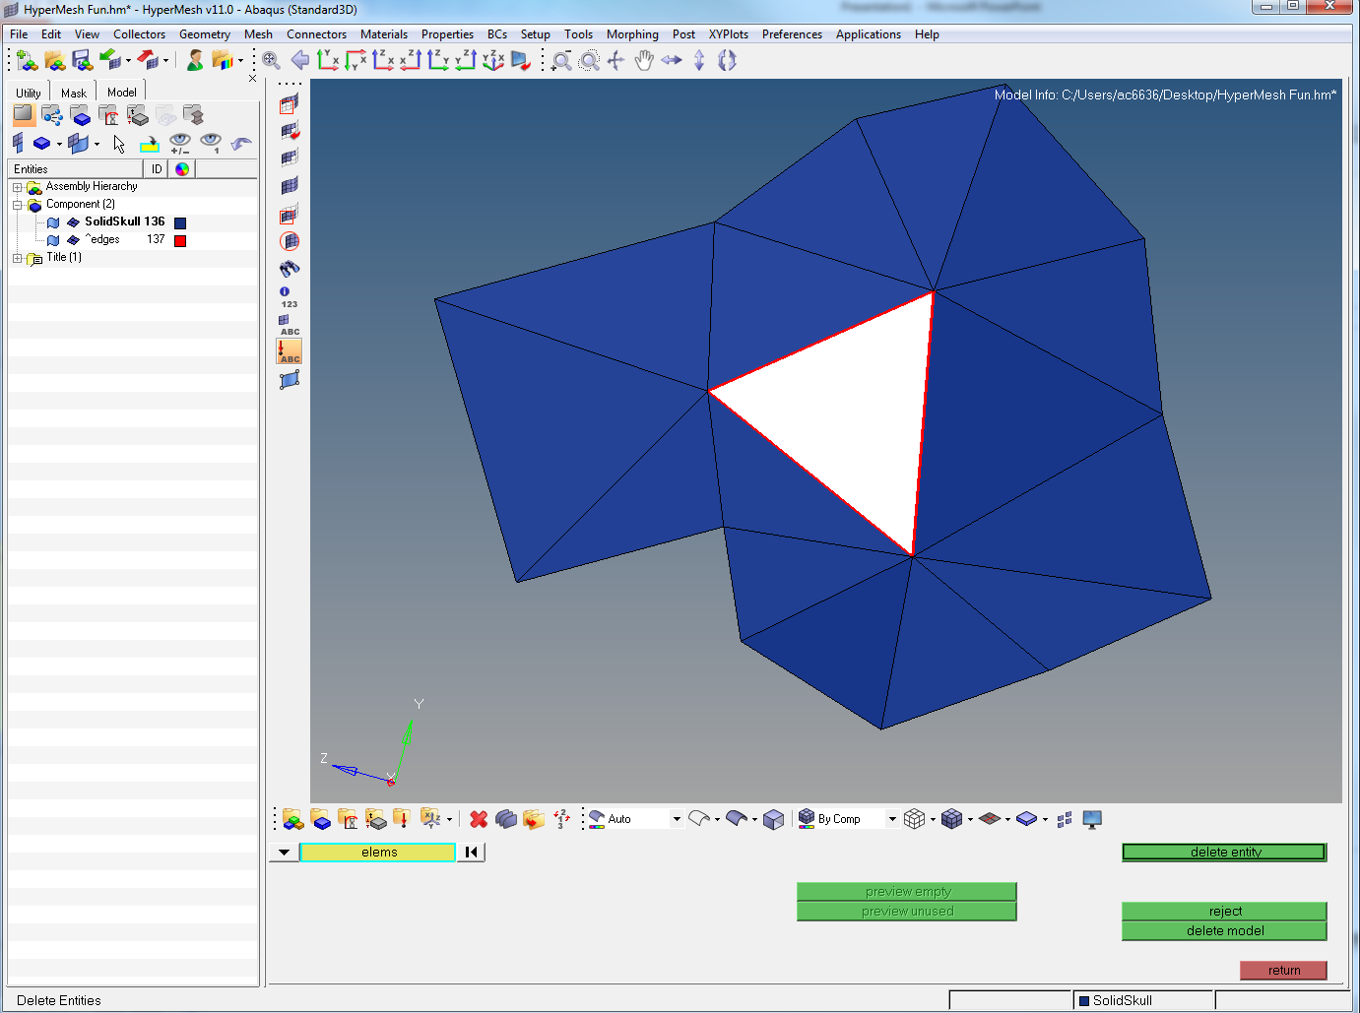
Notes:
Delete the entity in the middle (F2). Repeat until none in the middle

Slide 42
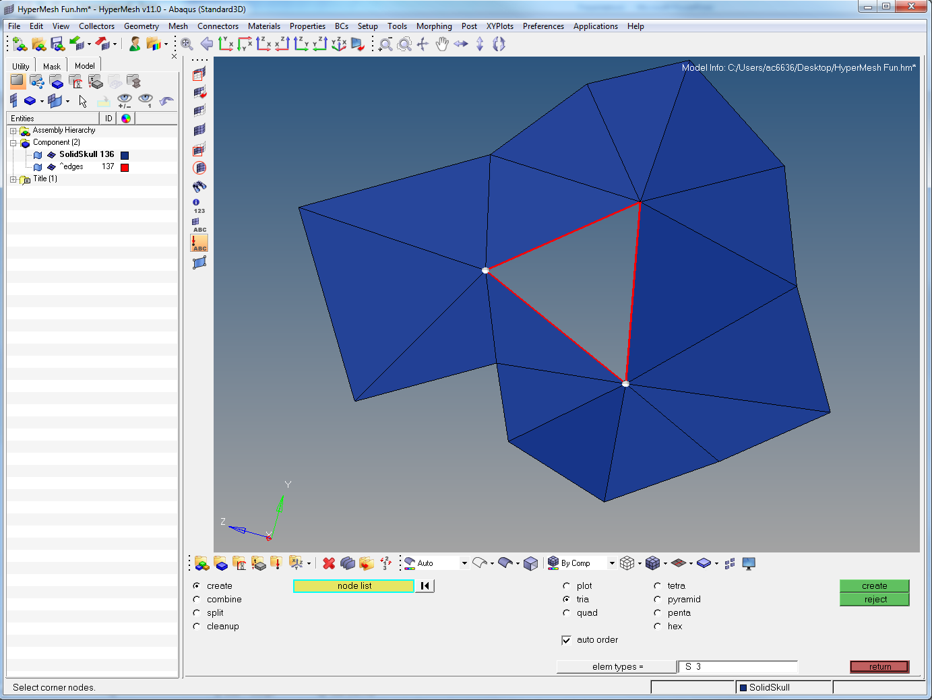
Notes:
Then rebuild the element (F6) as before.

Slide 43
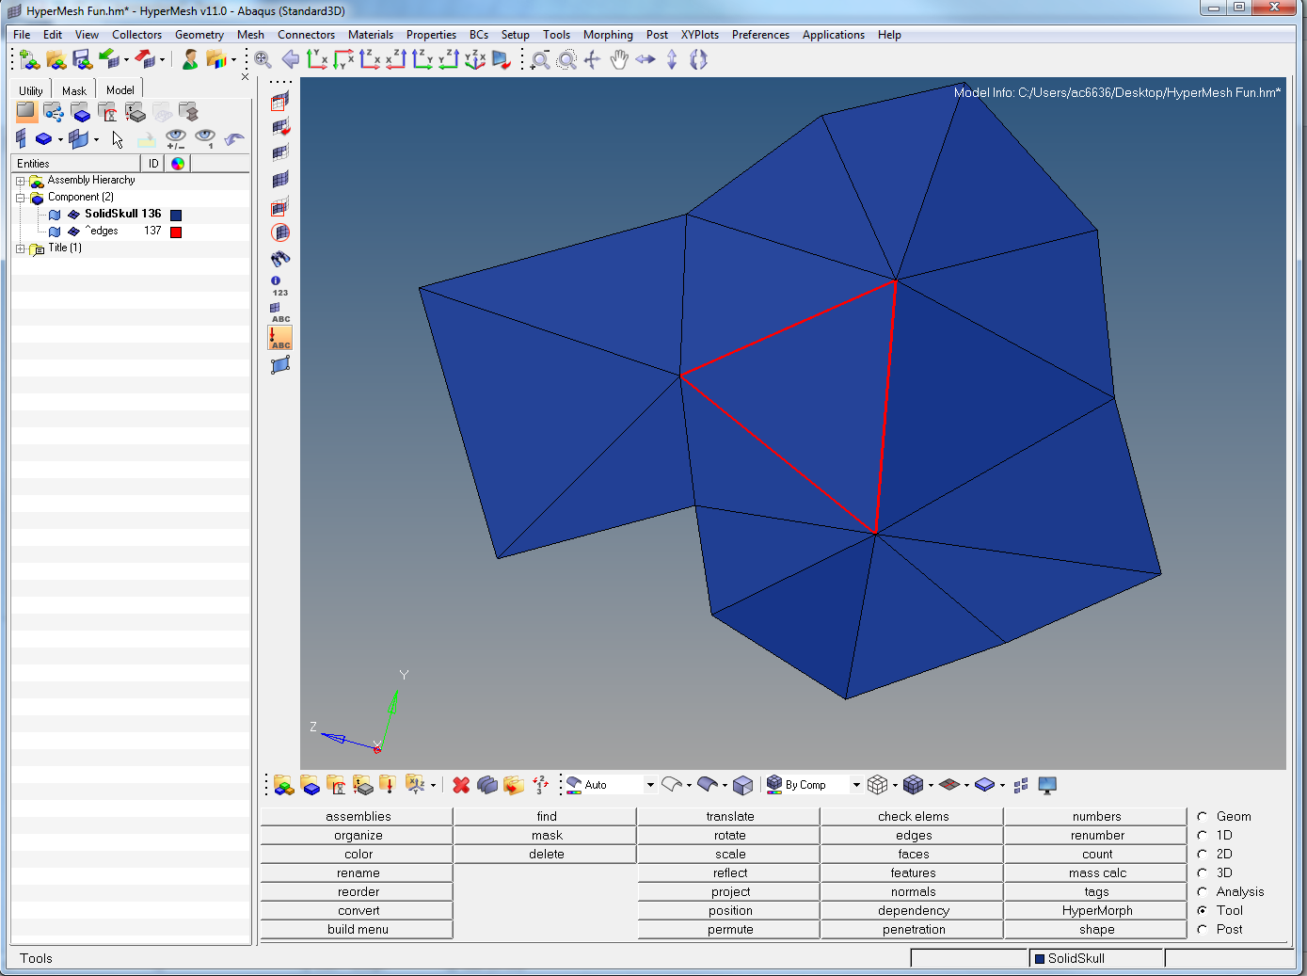
Notes:
Now to hide the ones you’ve fixed, go to Tool > mask (2nd column, 2nd down or F5).

Slide 44
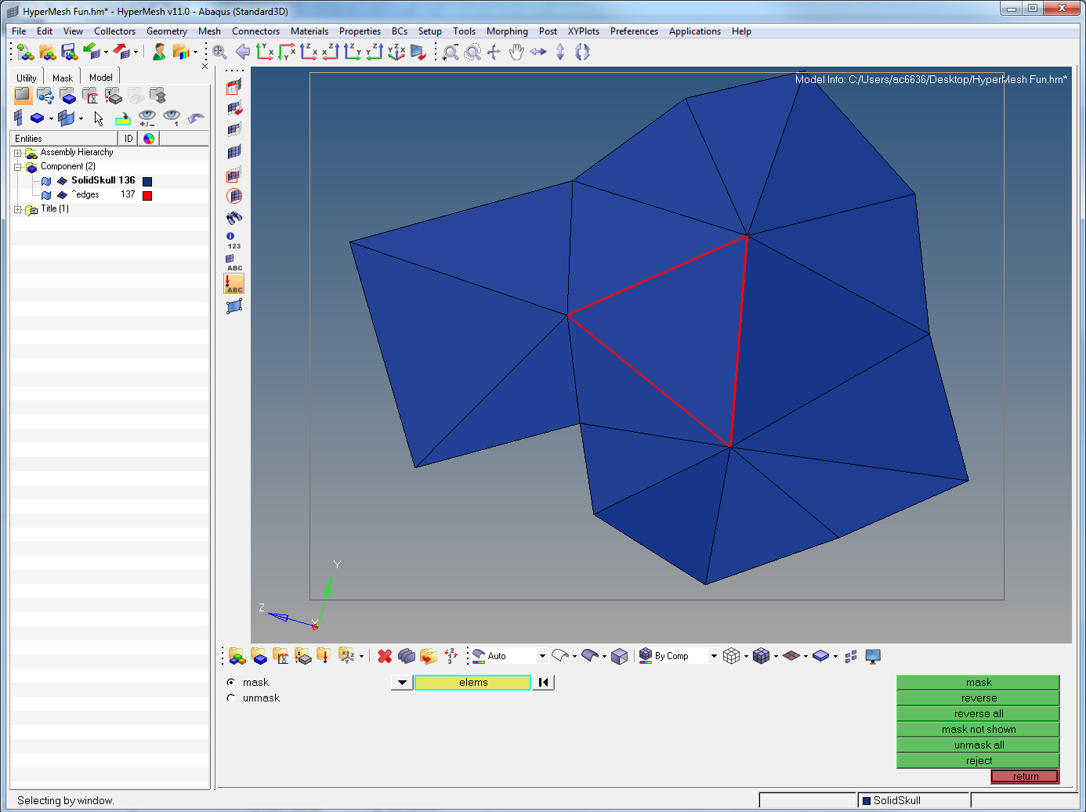
Notes:
Shift + left click drag over the elements and release

Slide 45
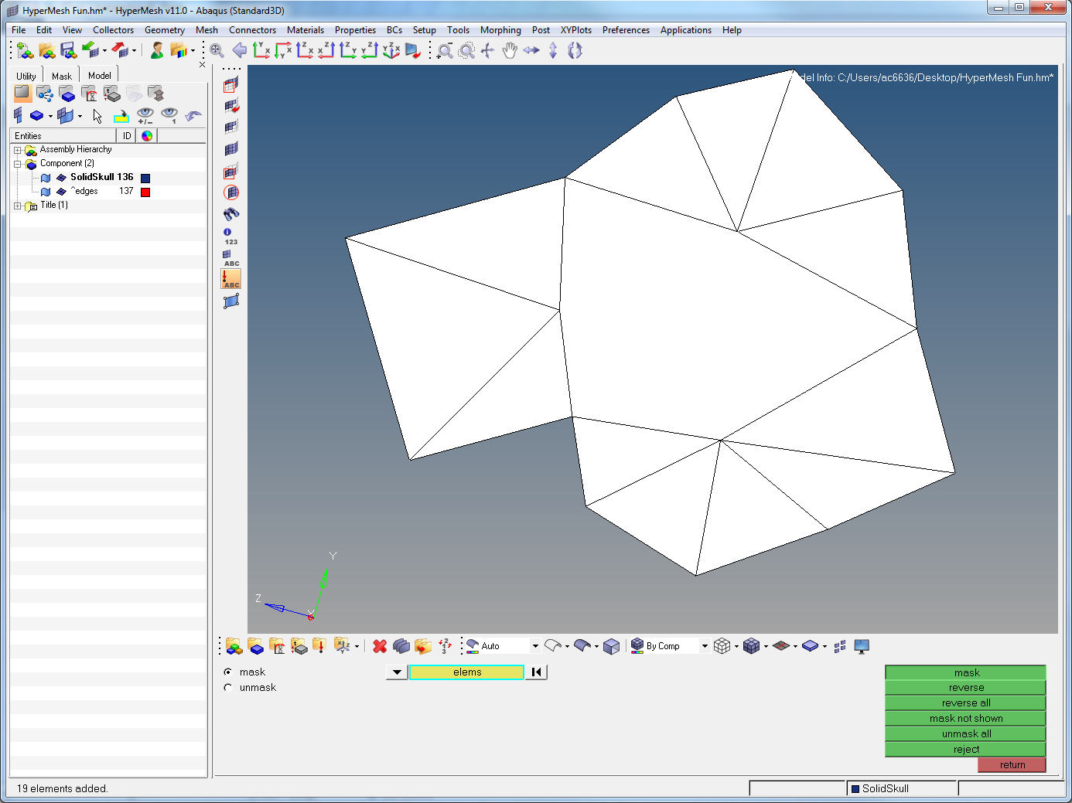
Notes:
This highlights them all. Press mask.

Slide 46
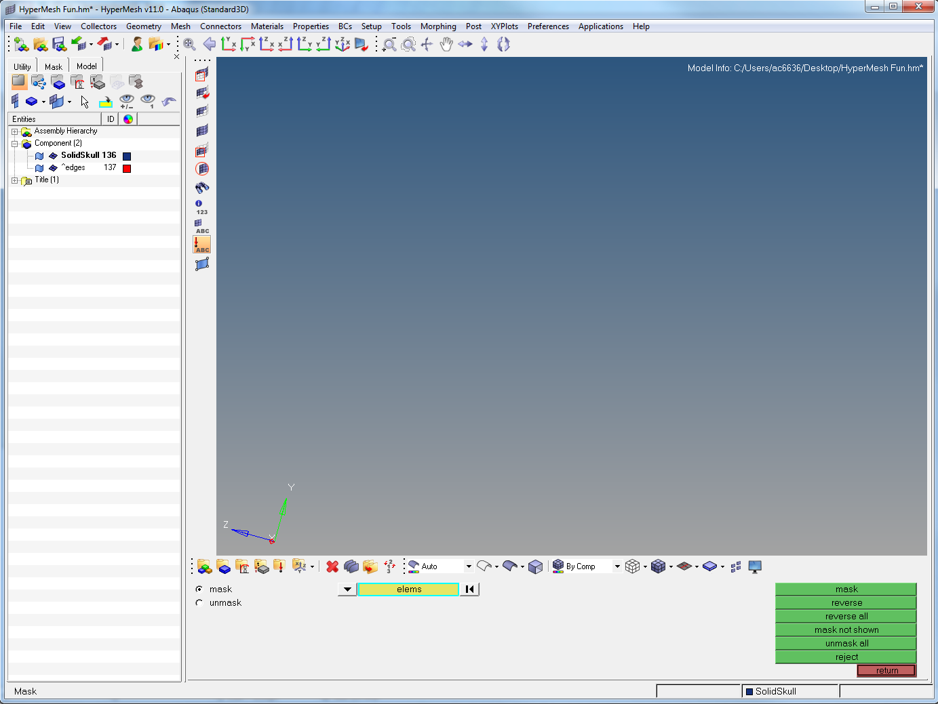
Notes:
These elements are now hidden

Slide 47
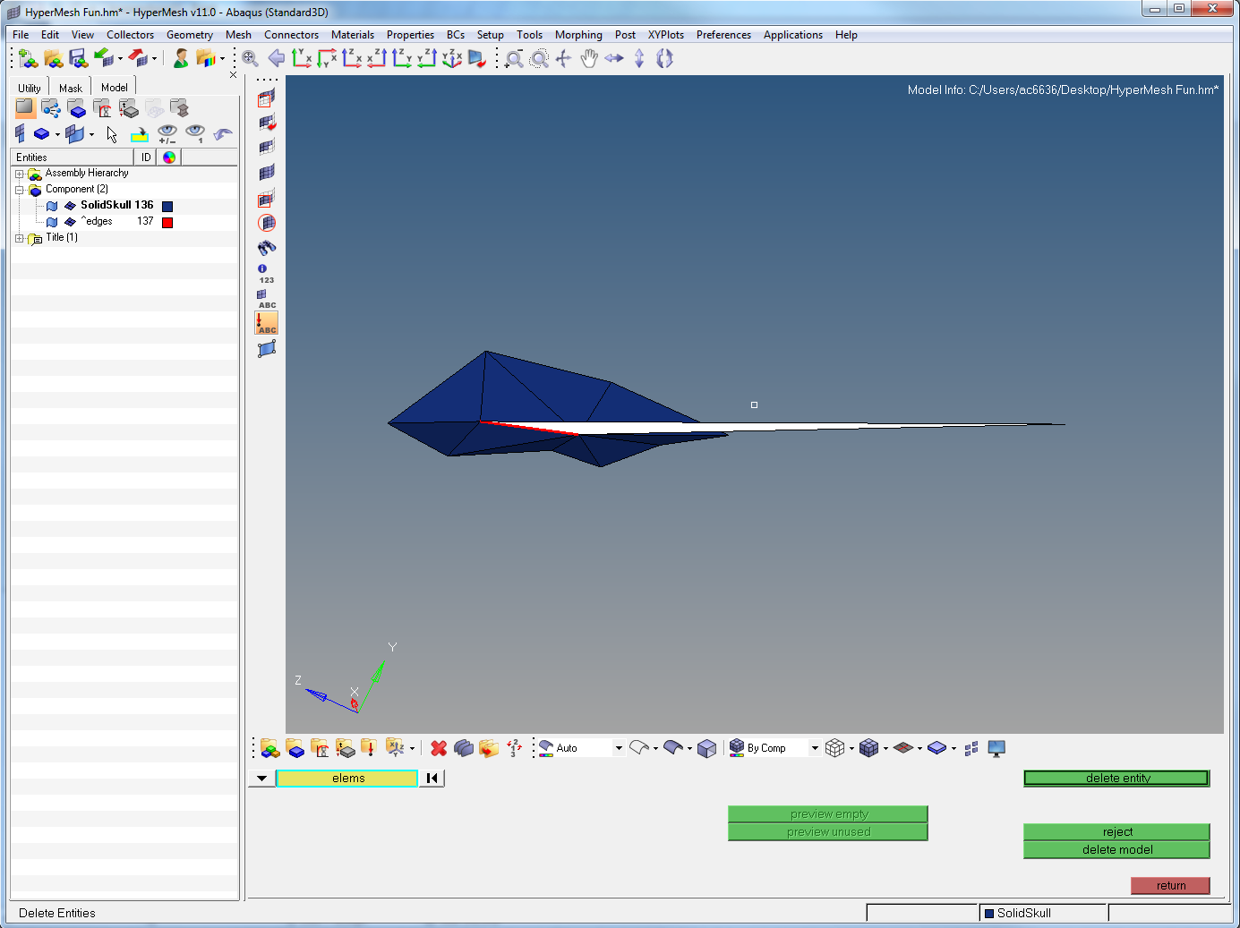
Notes:
Find the next failed one (this is a good one). Just delete the silly element, and then mask the remaining elements as above

Slide 48

Notes:
Just these 2 left. Zoom in on the right hand one

Slide 49
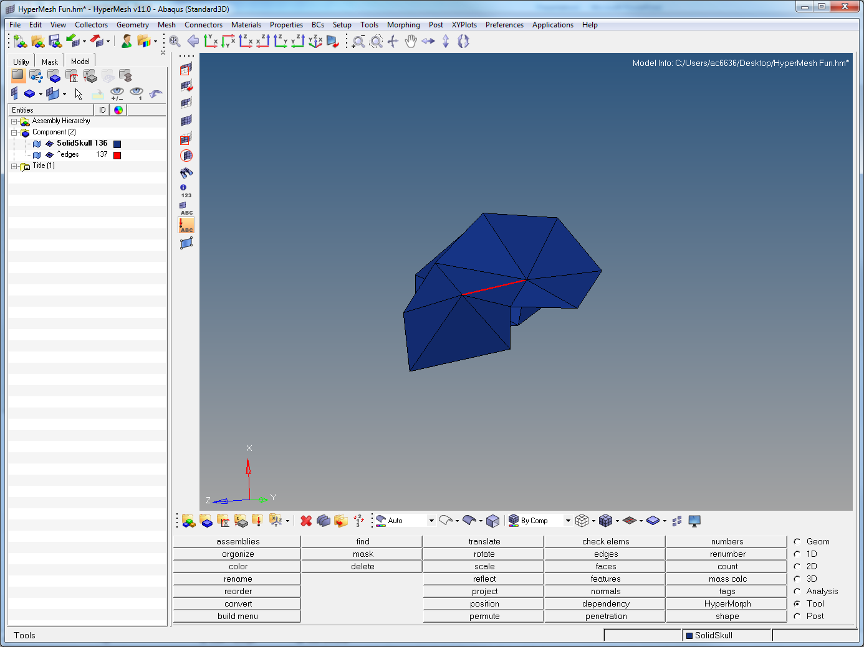
Notes:
Here you can see what appears to be one error

Slide 50
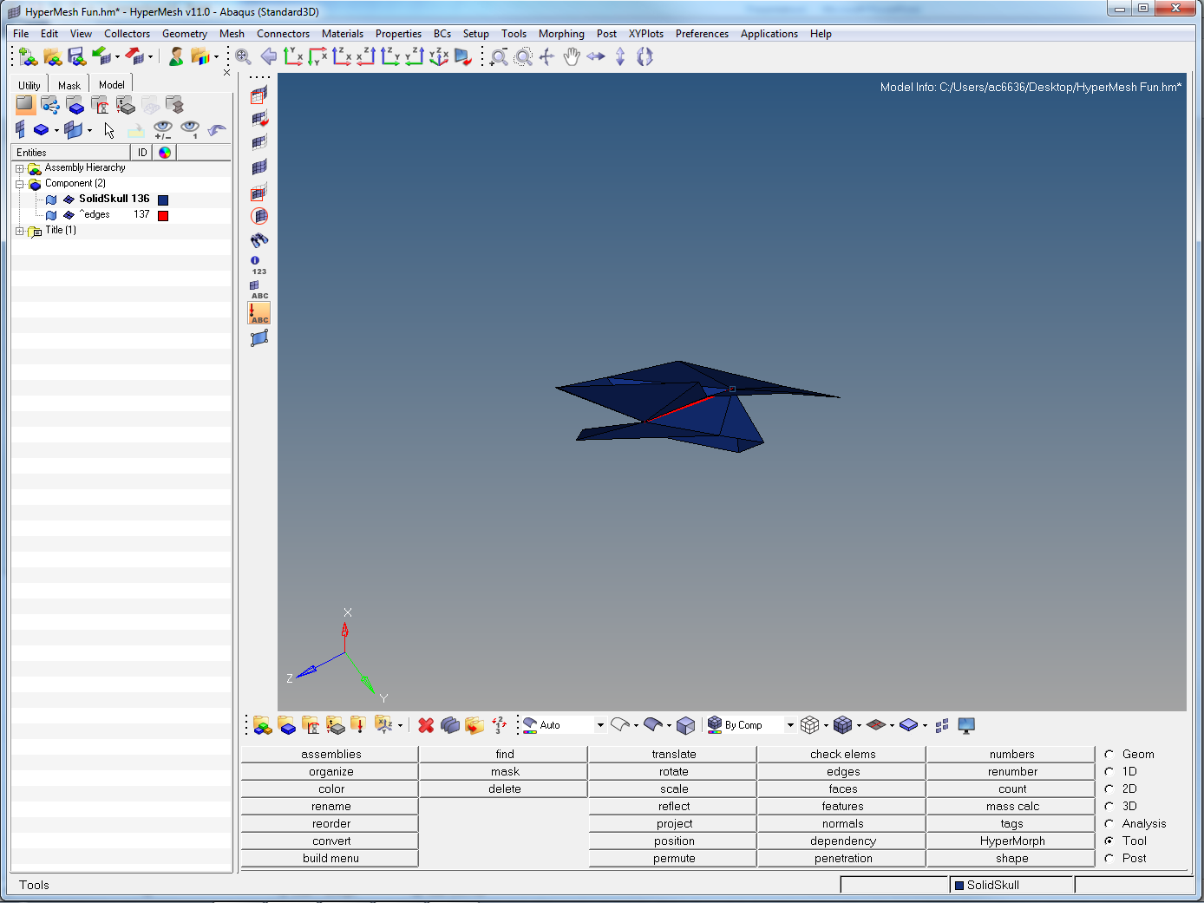
Notes:
If you rotate you can see that the 2 layers have stuck themselves to each other.

Slide 51
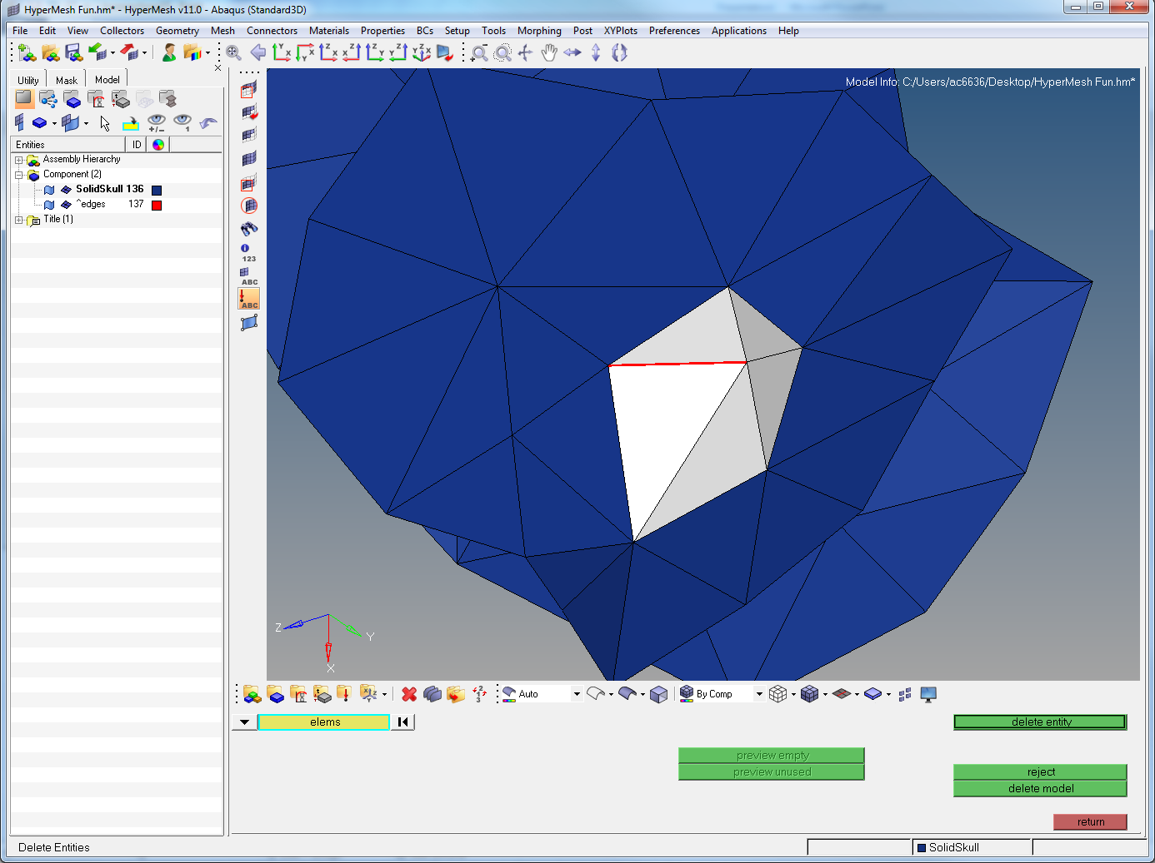
Notes:
Easiest way is to delete those surrounding the join

Slide 52
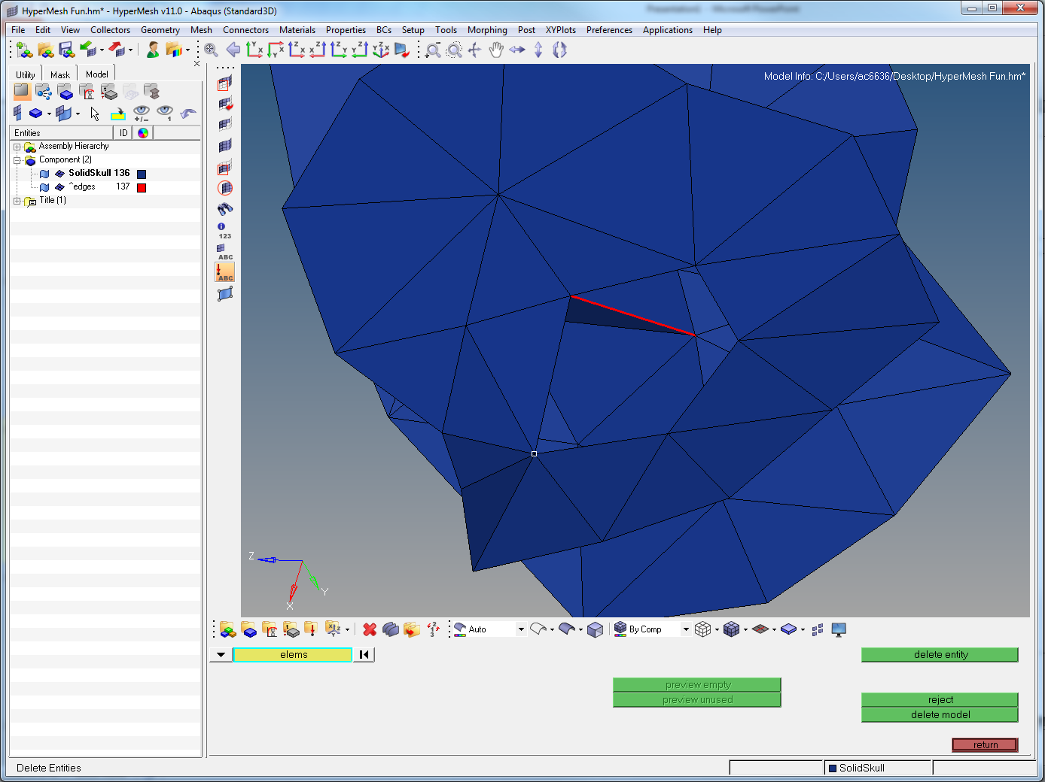
Notes:
Half done

Slide 53
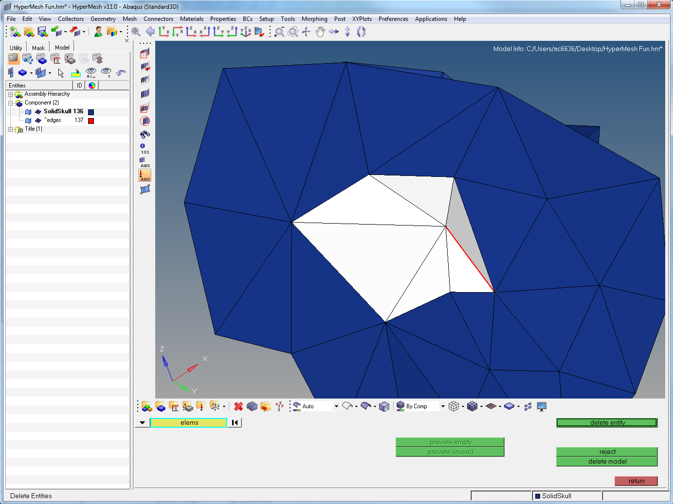
Notes:
Repeat on other side

Slide 54
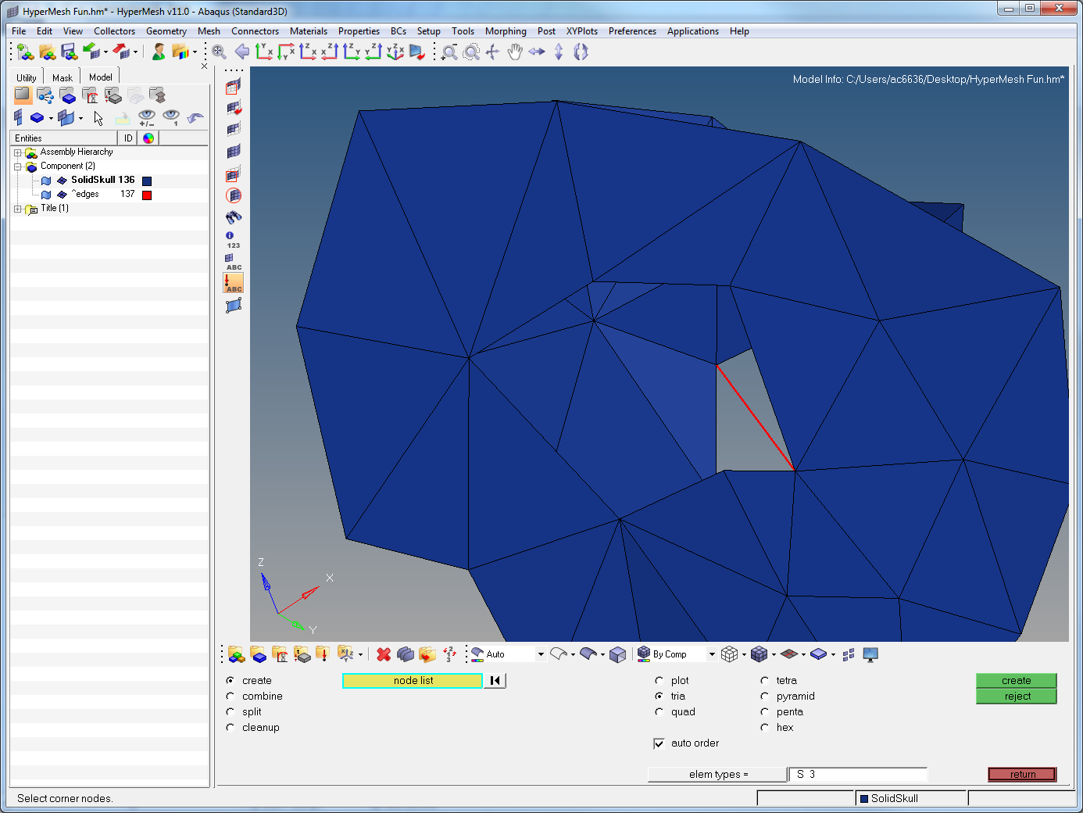
Notes:
Then rebuild the triangles in

Slide 55
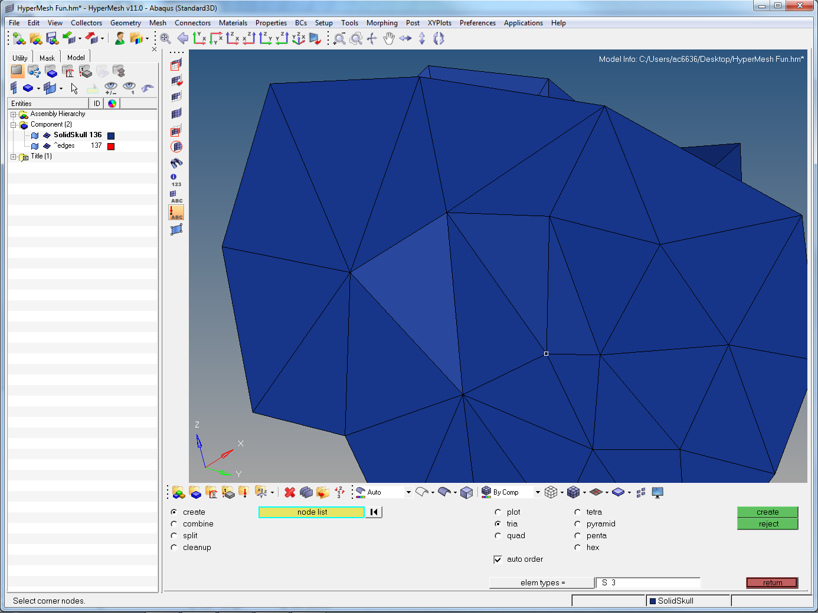
Notes:
Et voila. Fixed. Mask the elements and find the last errors

Slide 56
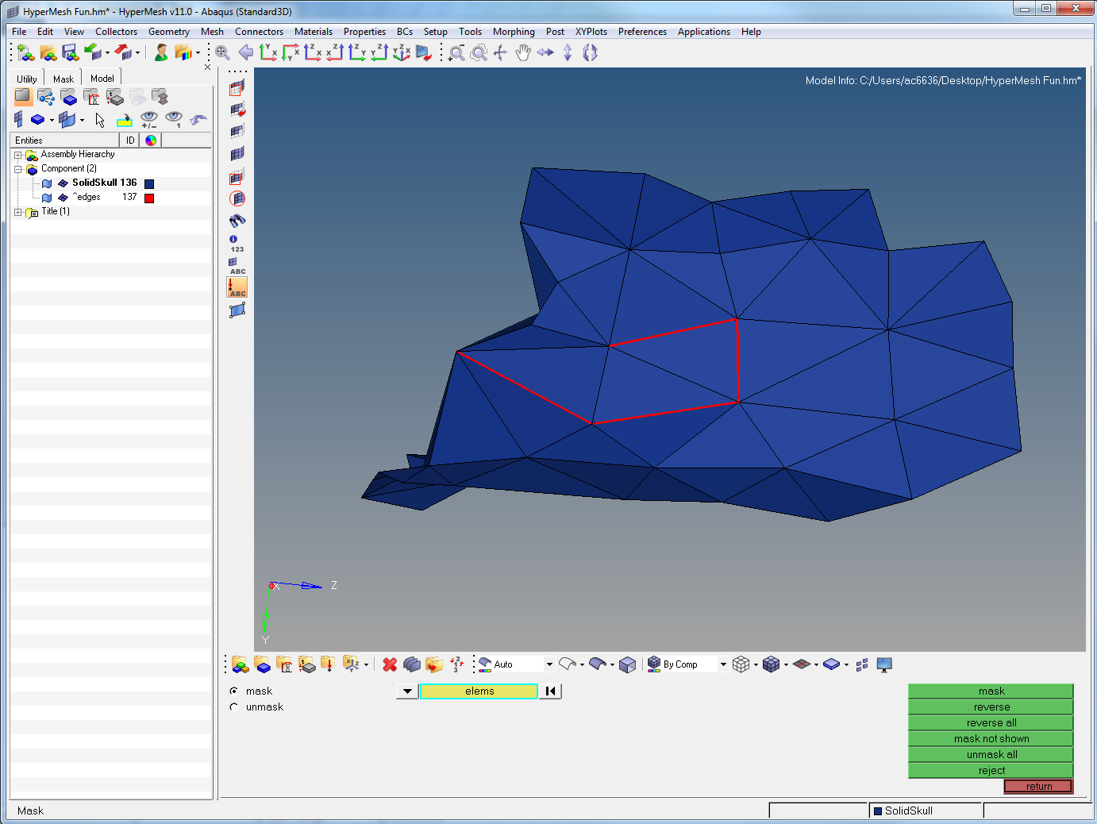
Notes:
I leave this one up to you, although Id suggest deleting elements and rebuilding, but be sure to keep the finished geometry as close as possible to the original

Slide 57
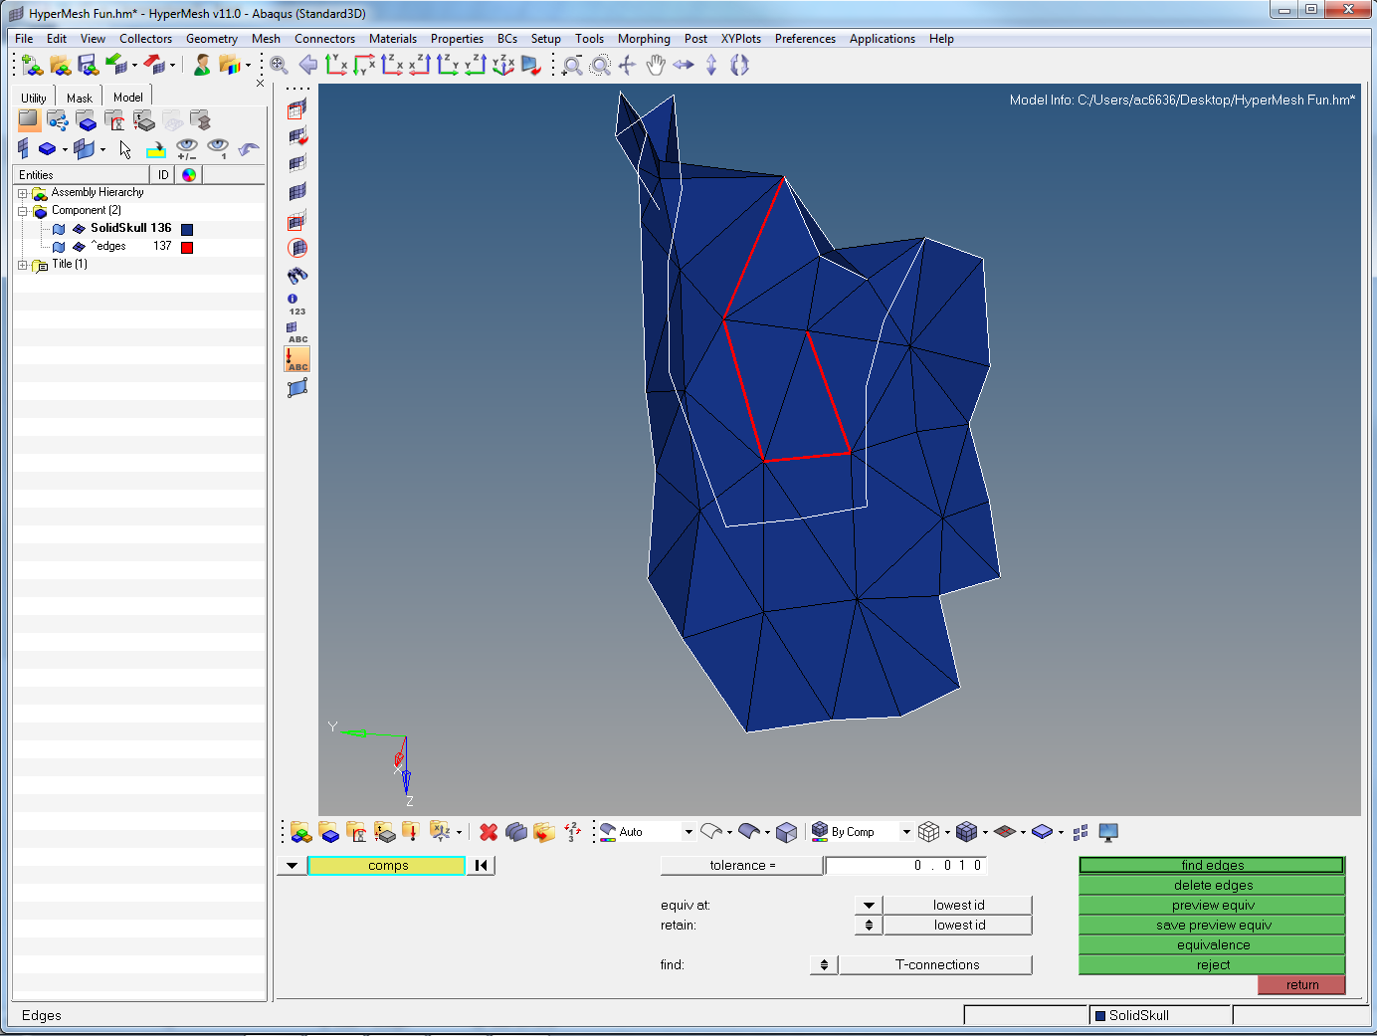
Notes:
When finished, go back to the edges panel (Shift+F3), click on the model, and press find edges again.

Slide 58

Notes:
Hopefully your result is this… no t connections found and the ^edges component disappears

Slide 59

Notes:
Time to check free edges. Press the up/down arrow to change it from t-connections back to free edges. Click on the model again, and then click find edges.

Slide 60

Notes:
As with t-connections, a new component appears again. Hide the solidskull component again by clicking the little box to the right of it.

Slide 61

Notes:
Then click unmask adjacent to show the problems with the surrounding elements. Zoom in on the right side failure

Slide 62

Notes:
Its just a hole… build a new element in. Then mask it.

Slide 63

Notes:
Go find this set. At first glance there appears to be nothing wrong…

Slide 64

Notes:
Zoom in to see the nodes have separated from each other

Slide 65

Notes:
Go to 2D > replace. Click one node (a grey or white blob will appear), then the other.

Slide 66

Notes:
This should zip that section up as it combines the 2 nodes.

Slide 67

Notes:
Repeat on the other sections. NB there is sometimes an easier way to fix things like that. There is a Tolerance area showing 0.010 presently. If you click equivalence this will zip together all nodes that are within that distance of each other but not connected. Can be useful for minor gaps like this, but can be a pain as they tend to stick narrow areas together. Experience will tell you which is the best way to deal with things.
When finished, click on the find edges again to make sure no more edges have been found.

Slide 68

Notes:
Now time to check dihedrals. If following Jen’s guide you can skip step 4 as it wont apply. Click the Utility tab (top left), then Geom/Mesh

Slide 69

Notes:
Then click Quick Tetramesh

Slide 70

Notes:
Click on the Components button. It might take 2 goes to get to the next screen

Slide 71

Notes:
Click comps

Slide 72

Notes:
Tick the box and press select

Slide 73

Notes:
Click proceed

Slide 74

Notes:
Then click Dihedrals. It will reveal these ones. Zoom in on the main one in the centre of the square

Slide 75

Notes:
It looks like this. There are 2 types of dihedrals: tight angles and wide angles. This is an example of a wide angle. Basically they will normally be triangles with nothing apparently wrong with them

Slide 76

Notes:
To find out what is wrong with them, go to Tool > Normals (Shift+F10). Make sure comps is selected and click on the mesh again, and click the up down arrow next to Vector display normals. Change this to Colour display normals and hit display normals

Slide 77

Notes:
Now you can see the issue. Elements have an “inside” (red) and an “outside” (blue). Sometimes elements get confused which way around they are supposed to be or you build them in backwards. Fret not as its an easy fix.

Slide 78

Notes:
Click the orientation elem and then click an element on screen that is the “correct” way around. The click adjust normals. You can always reverse normals if they are backwards when you unmask all.

Slide 79

Notes:
They are now all the same!

Slide 80

Notes:
Recheck the dihedrals again, and only this one should appear.

Slide 81

Notes:
If you rotate you can see its not the same as the others. This is a “tight” angle. One where the elements on each side of the node are within 30 degrees of each other

Slide 82

Notes:
Depending on the circumstance you can either 2D > elem offset; merge the nodes with the 2D > replace; or delete and rebuild. I chose to replace the nodes, but this was personal preference

Slide 83

Notes:
When finished recheck and fix until this appears after a recheck.

Slide 84

Notes:
Time to do element quality checks. Go to Tool > Check elems (same place as duplicates also F10). First up is aspect ratio. Ideally all will be below 5, but up to 10 is often acceptable. Don’t get lazy if there aren’t many to fix though… As before, click Aspect then Save failed.

Slide 85

Notes:
I like to keep them intact, but you could delete them as with duplicates and then go back to edges and check for free edges, and fix them as needed. Go to Tool > mask. Click elems

Slide 86

Notes:
Retrieve.

Slide 87

Notes:
mask

Slide 88

Notes:
reverse

Slide 89

Notes:
These are the 76 that failed. Zoom in, unmask adjacent, and fix as with other errors. Repeat this cycle for min angle (again ideally 20, but can go as low as 10), and max angle (>150).

Slide 90

Notes:
To create new components for the tetrameshing, follow above and then give it a name (tetmeshed for example). NB NO NUMBERS AS ABAQUS DOESN’T LIKE THEM

Slide 91

Notes:
Make sure it is current by right clicking and pressing make current (it will be listed in bold). Then click 3D > tetramesh

Slide 92

Notes:
Click Tetramesh parameters, then select gradual.

Slide 93

Notes:
Make sure it says comps in the blue box and click the skull somewhere. Then click mesh.

Slide 94

Notes:
This can take a while depending on the machine and size of the model. When it finishes it will list the number of elements in the bottom left.

Slide 95

Notes:
To create a new material, click the Materials area (red arrow – Folder with a hourglass under a bell curve?)

Slide 96

Notes:
Enter a mat name, select type = MATERIAL and card image = ABAQUS_MATERIAL. Then click create/edit

Slide 97

Notes:
Scroll down and click Elastic then enter your Youngs modulus (E1) and Poisson ratio (NU 1). Click return.
NBMake sure you have everything scaled correctly for this bit! TO check go to Geom > Distance and pick to points a known distance apart and see how big it is. Use 2D > scale to get it to the correct size in nm/mm/cm/m etc.

Slide 98

Notes:
Then click Properties (folder with a grey square on it, next to the materials).

Slide 99

Notes:
Enter a property name, type = SOLID SECTION, Card image = SOLIDSECTION, Material = (whatever you named your material). Click create

Slide 100

Notes:
Then go to assign. Shift + left click drag over all elements, then click assign.

